Slide 1
The Endocrine System
Endocrine Glands:
Secretion and Action of Hormones

Slide 2
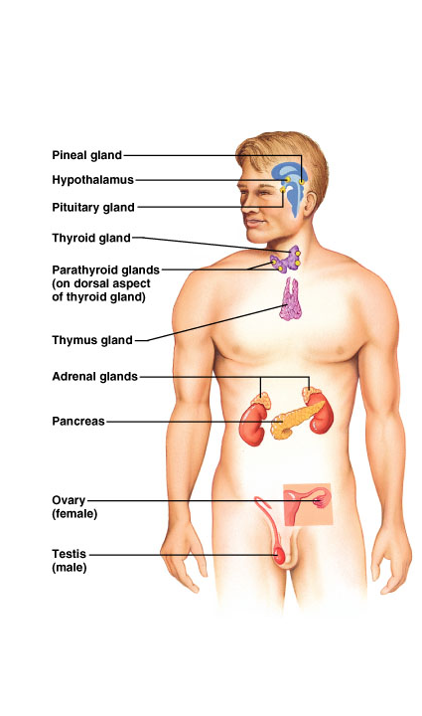
Endocrine Organs
Purely endocrine organs
Pituitary gland
Pineal gland
Thyroid gland
Parathyroid glands
Adrenal: 2 glands
Cortex
Medulla
Endocrine cells in other organs
Pancreas
Thymus
Gonads
Hypothalamus

Slide 3
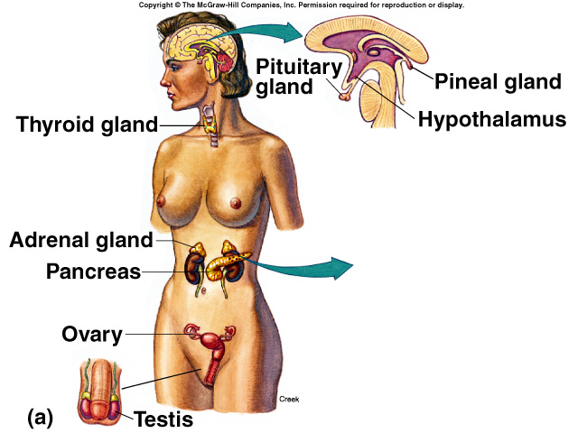
Overview of the Endocrine System
Controls longer term metabolic processes
Shares some functions with nervous system
System of ductless glands that secrete hormones
Secrete biologically active molecules into the blood.
Lack ducts.
Hormones are “messenger molecules”
Circulate in the blood
Act on distant target cells
Target cells respond to the hormones for which they have receptors
The effects are dependent on the programmed response of the target cells
Hormones are just molecular triggers
Hormones change metabolism of many cells
Release controlled by negative feedback

Slide 4
Hormones
Neurohormone:
Specialized neurons that secrete chemicals into the blood rather than synaptic cleft.
Chemical secreted is called neurohormone.
Hormones:
Affect metabolism of target organs.
Help regulate total body metabolism, growth, and reproduction.
Basic categories of hormones
Amino acid based:
modified amino acids (or amines),
peptides (short chains of amino acids), and
proteins (long chains of amino acids)
Steroids:
lipid molecules derived from cholesterol

Slide 5
Chemical Classification of Hormones
Amines:
Hormones derived from tyrosine and tryptophan.
NE, Epi, T₄.
Polypeptides and proteins:
Polypeptides:
Chains of < 100 amino acids in length.
ADH.
Protein hormones:
Polypeptide chains with > 100 amino acids.
Growth hormone.

Slide 6
Chemical Classification of Hormones (continued)
Lipids derived from cholesterol.
Are lipophilic hormones.
Testosterone.
Estradiol.
Cortisol.
Progesterone.

Slide 7
Chemical Classification of Hormones (continued)
Glycoproteins:
Long polypeptides (>100) bound to 1 or more carbohydrate (CHO) groups.
FSH and LH.
Hormones can also be divided into:
Polar:
H₂0 soluble.
Nonpolar (lipophilic):
H₂0 insoluble.
Can gain entry into target cells.
Steroid hormones and T₄.
Pineal gland secretes melatonin:
Has properties of both H₂0 soluble and lipophilic hormones.

Slide 8
Prohormones and Prehormones
Prohormone:
Precursor is a longer chained polypeptide that is cut and spliced together to make the hormone.
Proinsulin.
Preprohormone:
Prohormone derived from larger precursor molecule.
Preproinsulin.
Prehormone:
Molecules secreted by endocrine glands that are inactive until changed into hormones by target cells.
T₄ converted to T₃.

Slide 9
Hormonal Interactions
Synergistic:
Two hormones work together to produce a result.
Additive:
Each hormone separately produces response, together at same concentrations stimulate even greater effect.
NE and Epi.
Complementary:
Each hormone stimulates different step in the process.
FSH and testosterone.

Slide 10
Hormonal Interactions (continued)
Permissive effects:
Hormone enhances the responsiveness of a target organ to second hormone.
Increases the activity of a second hormone.
Prior exposure of uterus to estrogen induces formation of receptors for progesterone.
Antagonistic effects:
Action of one hormone antagonizes the effects of another.
Insulin and glucagon.

Slide 11
Effects of [Hormone] on Tissue Response
[Hormone] in blood reflects the rate of secretion.
Half-life:
Time required for the blood [hormone] to be reduced to ½ reference level.
Minutes to days.
Normal tissue responses are produced only when [hormone] are present within physiological range.
Varying [hormone] within normal, physiological range can affect the responsiveness of target cells.

Slide 12
Effects of [Hormone] on Tissue Response (continued)
Priming effect (upregulation):
Increase number of receptors formed on target cells in response to particular hormone.
Greater response by the target cell.
Desensitization (downregulation):
Prolonged exposure to high [polypeptide hormone].
Subsequent exposure to the same [hormone] produces less response.
Decrease in number of receptors on target cells.
Insulin in adipose cells.
Pulsatile secretion may prevent downregulation.

Slide 13
Mechanisms of Hormone Action
Hormones of same chemical class have similar mechanisms of action.
Similarities include:
Location of cellular receptor proteins depends on the chemical nature of the hormone.
Events that occur in the target cells.
To respond to a hormone:
Target cell must have specific receptors for that hormone (specificity).
Hormones exhibit:
Affinity (bind to receptors with high bond strength).
Saturation (low capacity of receptors).

Slide 14
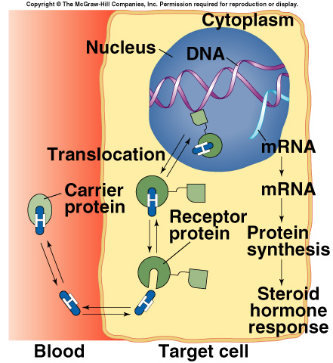
Hormones That Bind to Nuclear Receptor Proteins
Lipophilic steroid and thyroid hormones are attached to plasma carrier proteins.
Hormones dissociate from carrier proteins to pass through lipid component of the target plasma membrane.
Receptors for the lipophilic hormones are known as nuclear hormone receptors.

Slide 15
Nuclear Hormone Receptors
Steroid receptors are located in cytoplasm and in the nucleus.
Function within cell to activate genetic transcription.
Messenger RNA directs synthesis of specific enzyme proteins that change metabolism.
Each nuclear hormone receptor has 2 regions:
A ligand (hormone)-binding domain.
DNA-binding domain.
Receptor must be activated by binding to hormone before binding to specific region of DNA called HRE (hormone responsive element).
Located adjacent to gene that will be transcribed.

Slide 16
Hormones That Use 2nd Messengers
Hormones cannot pass through plasma membrane use 2nd messengers.
Catecholamine, polypeptide, and glycoprotein hormones bind to receptor proteins on the target plasma membrane.
Actions are mediated by 2nd messengers (signal-transduction mechanisms).
Extracellular hormones are transduced into intracellular 2nd messengers.

Slide 17
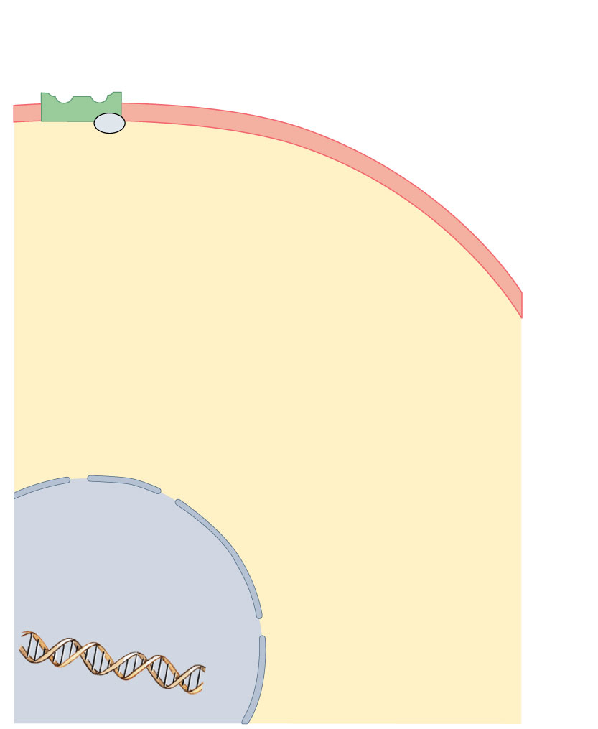
Membrane
receptor
G protein
(inactive)
Cell
membrane
Cytoplasm
Nuclear envelope
Nuclear pore
Nucleus
DNA

Slide 18
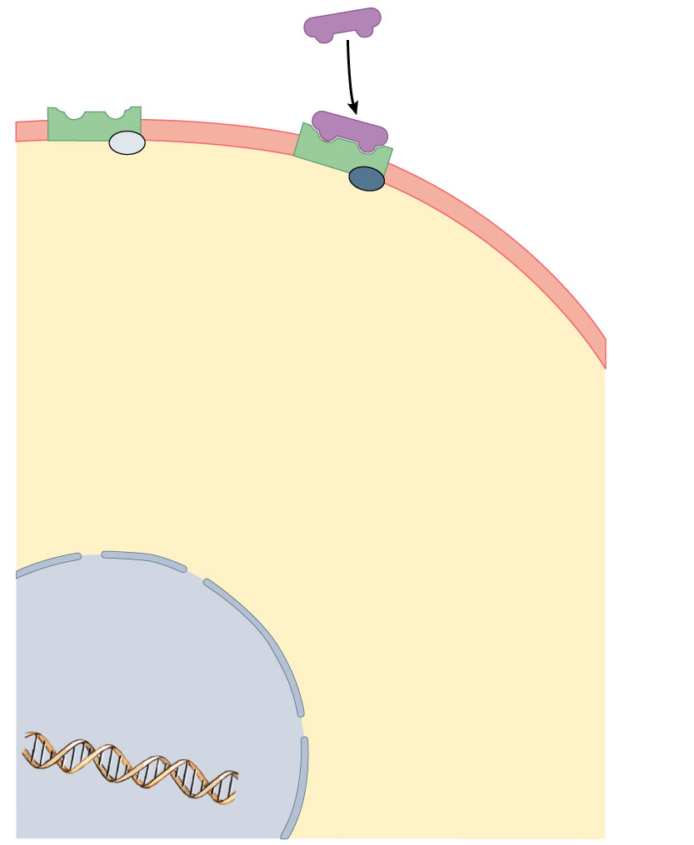
Membrane
receptor
Hormone-
receptor
complex
First messengers
(E, NE, peptide hormones,
and eicosanoids)
G protein
(inactive)
Cell
membrane
Cytoplasm
Nuclear envelope
Nuclear pore
Nucleus
DNA

Slide 19
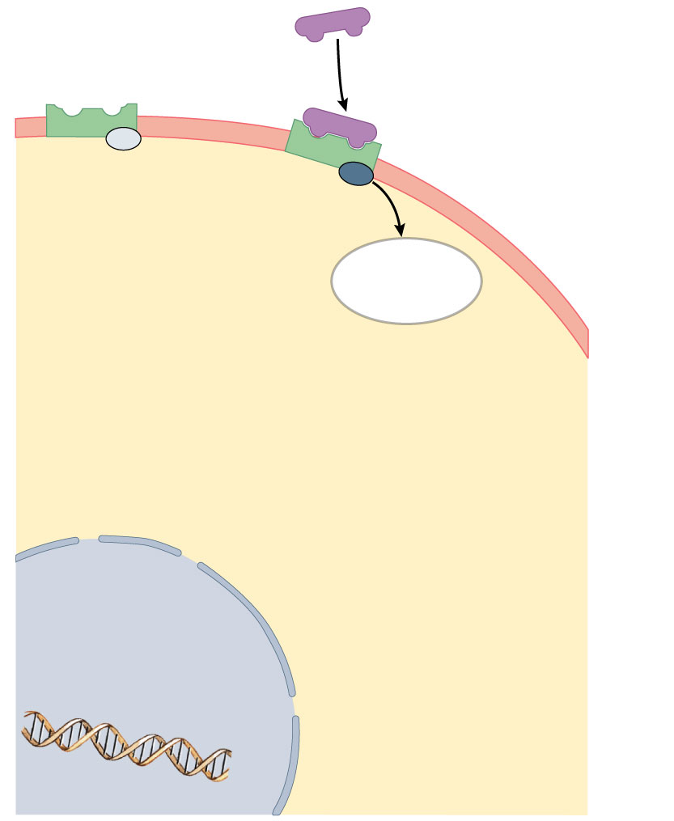
Membrane
receptor
Hormone-
receptor
complex
First messengers
(E, NE, peptide hormones,
and eicosanoids)
G protein
(inactive)
G protein
(activated)
Cell
membrane
Activates
adenylate
cyclase
Cytoplasm
Nuclear envelope
Nuclear pore
Nucleus
DNA

Slide 20
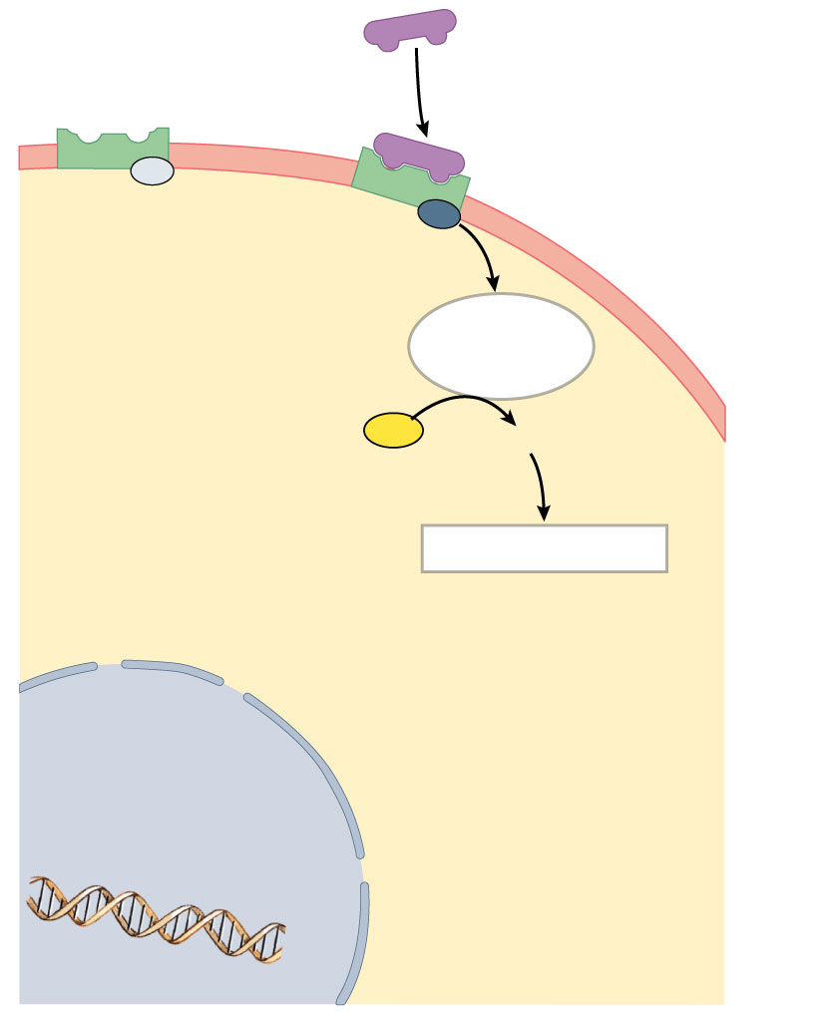
Membrane
receptor
Hormone-
receptor
complex
First messengers
(E, NE, peptide hormones,
and eicosanoids)
G protein
(inactive)
G protein
(activated)
Cell
membrane
Activates
adenylate
cyclase
ATP
cAMP
Acts as
second
messenger
Cytoplasm
Nuclear envelope
Activates kinase
Nuclear pore
Nucleus
DNA

Slide 21
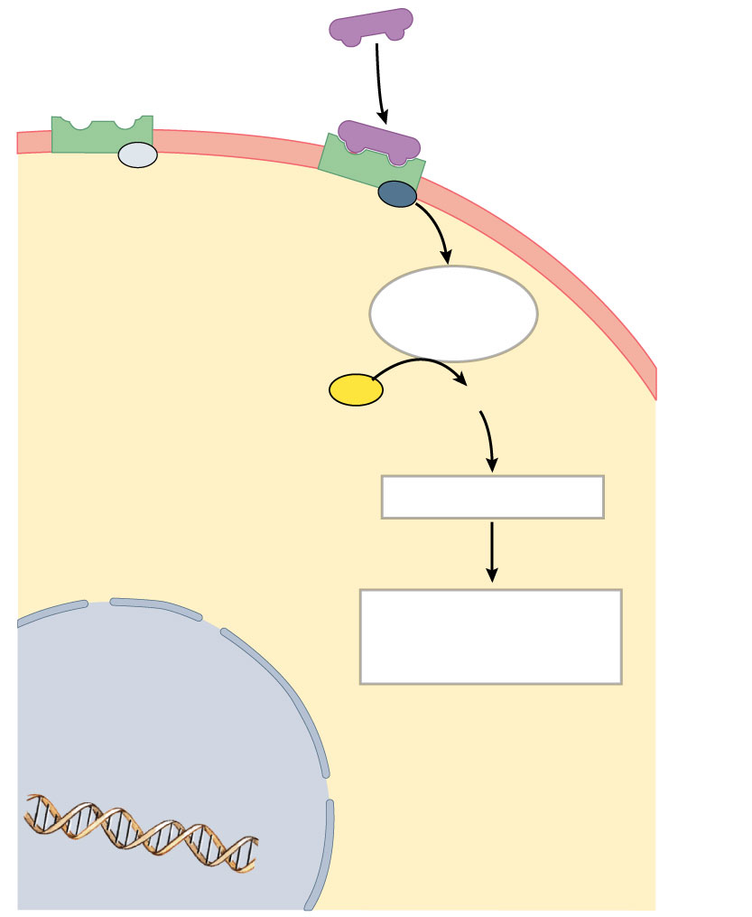
Membrane
receptor
Hormone-
receptor
complex
First messengers
(E, NE, peptide hormones,
and eicosanoids)
G protein
(inactive)
G protein
(activated)
Cell
membrane
Activates
adenylate
cyclase
ATP
cAMP
Acts as
second
messenger
Cytoplasm
Nuclear envelope
Activates kinase
Nuclear pore
Alterations in
enzyme activity;
opens ion channels
Nucleus
DNA

Slide 22
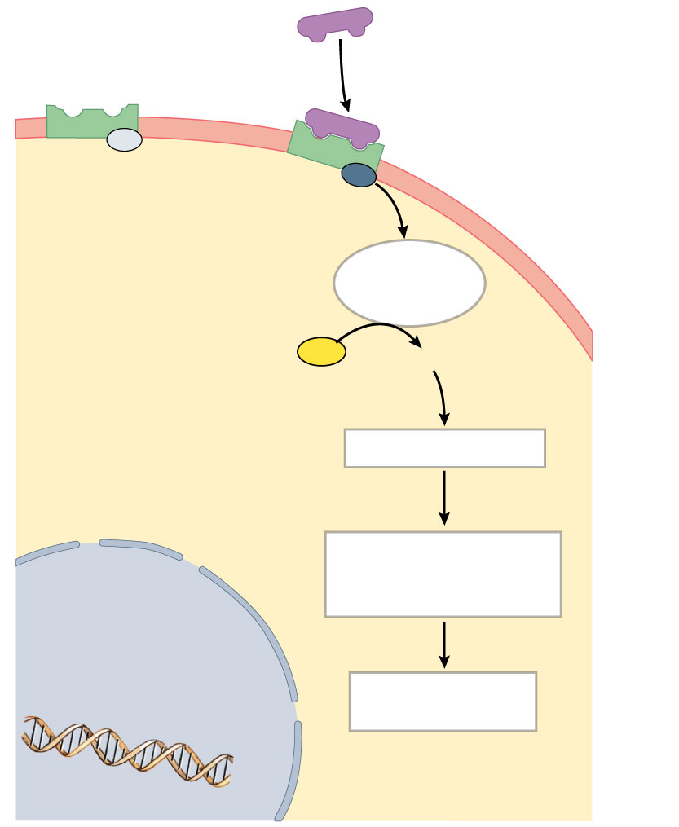
Membrane
receptor
Hormone-
receptor
complex
First messengers
(E, NE, peptide hormones,
and eicosanoids)
G protein
(inactive)
G protein
(activated)
Cell
membrane
Activates
adenylate
cyclase
ATP
cAMP
Acts as
second
messenger
Cytoplasm
Nuclear envelope
Activates kinase
Nuclear pore
Alterations in
enzyme activity;
opens ion channels
Nucleus
TARGET CELL
RESPONSE
DNA

Slide 23
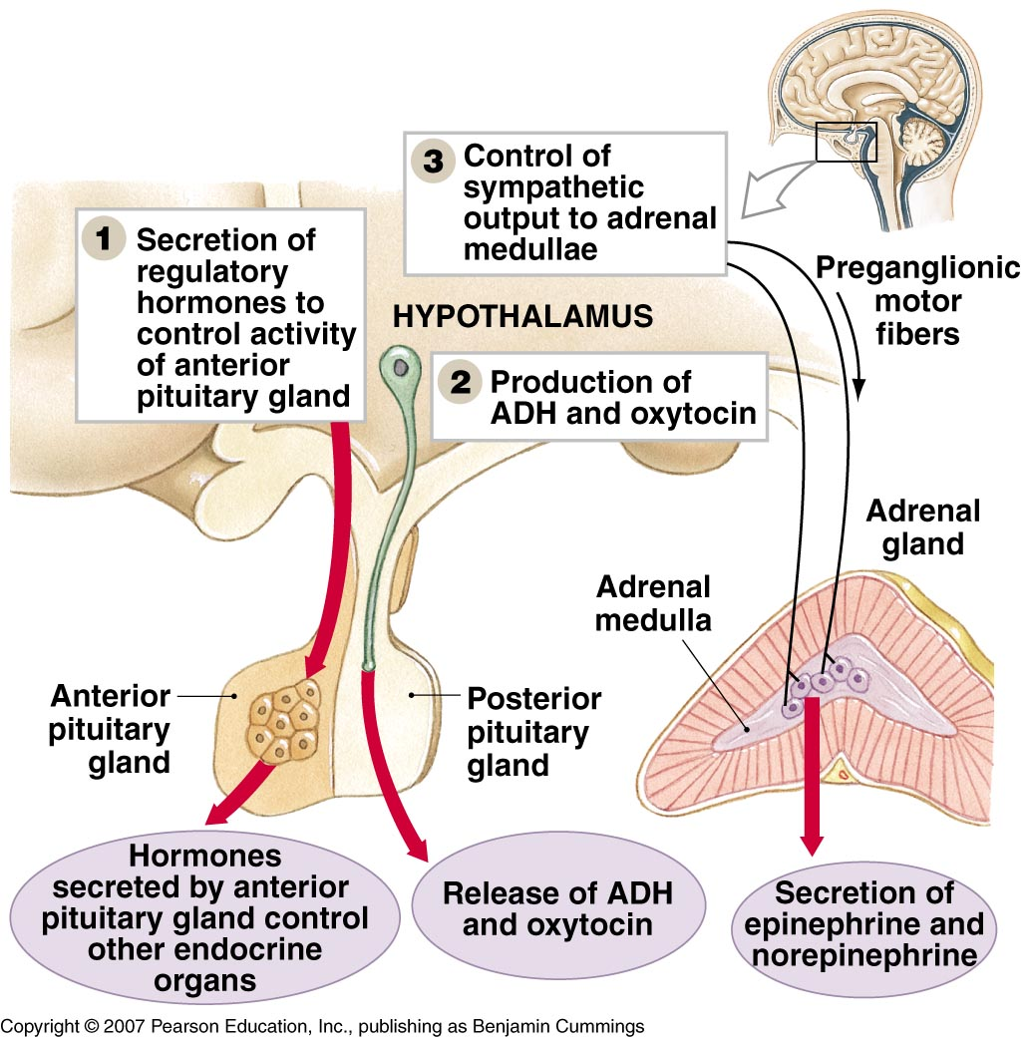
The hypothalamus is the Central control mechanism of the endocrine system
Three Mechanisms of Hypothalamic Control over Endocrine Organs
Hypothalamus releases hormones as an endocrine organ
Hypothalamus releases regulatory hormones to control pituitary gland endocrine cells
Autonomic centers cause direct neural control of adrenal medullae

Slide 24
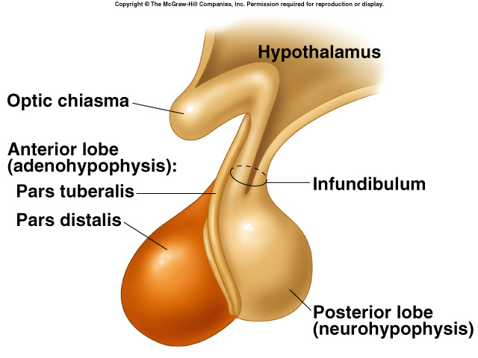
Pituitary Gland
Pituitary gland is located in the diencephalon.
Structurally and functionally divided into:
Anterior lobe.
Posterior lobe.

Slide 25
Pituitary Gland (continued)
Anterior pituitary:
Master gland (adenohypophysis).
Derived from a pouch of epithelial tissue that migrates upward from the mouth.
Consists of 2 parts:
Pars distalis: anterior pituitary.
Pars tuberalis: thin extension in contact with the infundibulum.
Posterior pituitary(neurohypophysis):
Formed by downgrowth of the brain during fetal development.
Is in contact with the infundibulum.
Nerve fibers extend through the infundibulum.

Slide 26
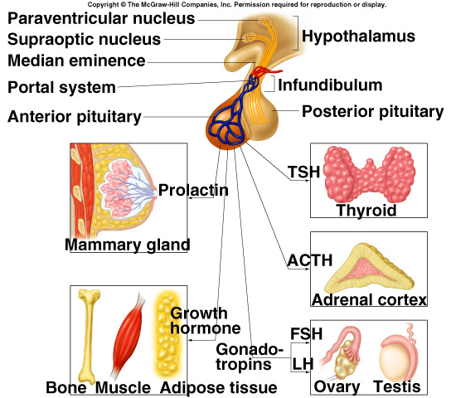
Pituitary Hormones
Anterior Pituitary:
Trophic effects:
High blood [hormone] causes target organ to hypertrophy.
Low blood [hormone] causes target organ to atrophy.
TSH: thyroid-stimulating hormone
ACTH: adrenocorticotropic hormone
FSH: follicle-stimulating hormone
LH: luteinizing hormone
GH: growth hormone
PRL: prolactin
MSH: melanocyte-stimulating hormone

Slide 27
Anterior Pituitary
The four tropic ones regulate the function of other hormones:
TSH stimulates the thyroid to produce thyroid hormone
ACTH stimulates the adrenal cortex to produce corticosteroids: aldosterone and cortisol
FSH stimulates follicle growth and ovarian estrogen production; stimulates sperm production and androgen-binding protein
LH has a role in ovulation and the growth of the corpus luteum; stimulates androgen secretion by interstitial cells in testes
The others from the anterior pituitary
GH (aka somatotropic hormone) stimulates growth of skeletal epiphyseal plates and body to synthesize protein
PRL stimulates mammary glands in breast to make milk
MSH stimulates melanocytes; may increase mental alertness

Slide 28
Pituitary Hormones (continued)
Posterior pituitary:
Stores and releases 2 hormones that are produced in the hypothalamus:
Antidiuretic hormone (ADH/vasopressin):
Promotes the retention of H₂0 by the kidneys.
Less H₂0 is excreted in the urine.
Oxytocin:
Stimulates contractions of the uterus during parturition.
Stimulates contractions of the mammary gland alveoli.
Milk-ejection reflex.

Slide 29
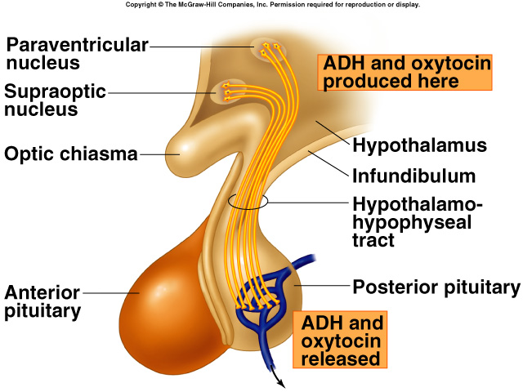
Hypothalamic Control of Posterior Pituitary
Hypothalamus neuron cell bodies produce:
ADH: supraoptic nuclei.
Oxytocin: paraventricular nuclei.
Transported along the hypothalamo-hypophyseal tract.
Stored in posterior pituitary.
Release controlled by neuroendocrine reflexes.

Slide 30
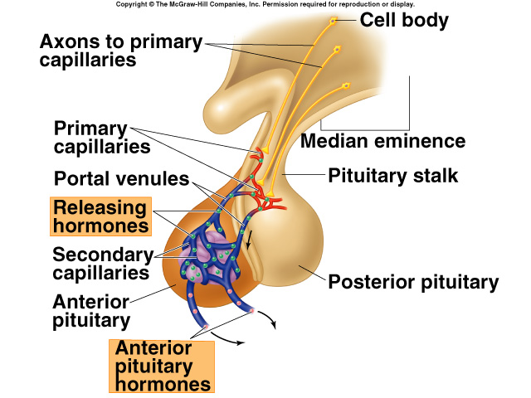
Hypothalamic Control of the Anterior Pituitary
Hormonal control rather than neural.
Hypothalamus neurons synthesize releasing and inhibiting hormones.
Hormones are transported to axon endings of median eminence.
Hormones secreted into the hypothalamo-hypophyseal portal system regulate the secretions of the anterior pituitary

Slide 31
Releasing hormones (releasing factors) of hypothalamus
Secreted like neurotransmitters from neuronal axons into capillaries and veins to anterior pituitary (adenohypophysis)
TRH (thyroid releasing hormone) -----turns on* TSH
CRH (corticotropin releasing hormone) -----turns on ACTH
GnRH (gonadotropin releasing hormone) ---turns on FSH and LH
PRF (prolactin releasing hormone) -----turns on PRL
GHRH (growth hormone releasing hormone) ----turns on GH
Inhibiting hormones of hypothalmus
PIF (prolactin inhibiting factor) -----turns off PRL
GH (growth hormone) inhibiting hormone ---turns off GH
The hypothalamus controls secretion of hormones which in their turn control the secretion of hormones by the thyroid gland, the adrenal cortex and gonads: in this way the brain controls these endocrine glands
*Note: “turns on” means causes to be released

Slide 32
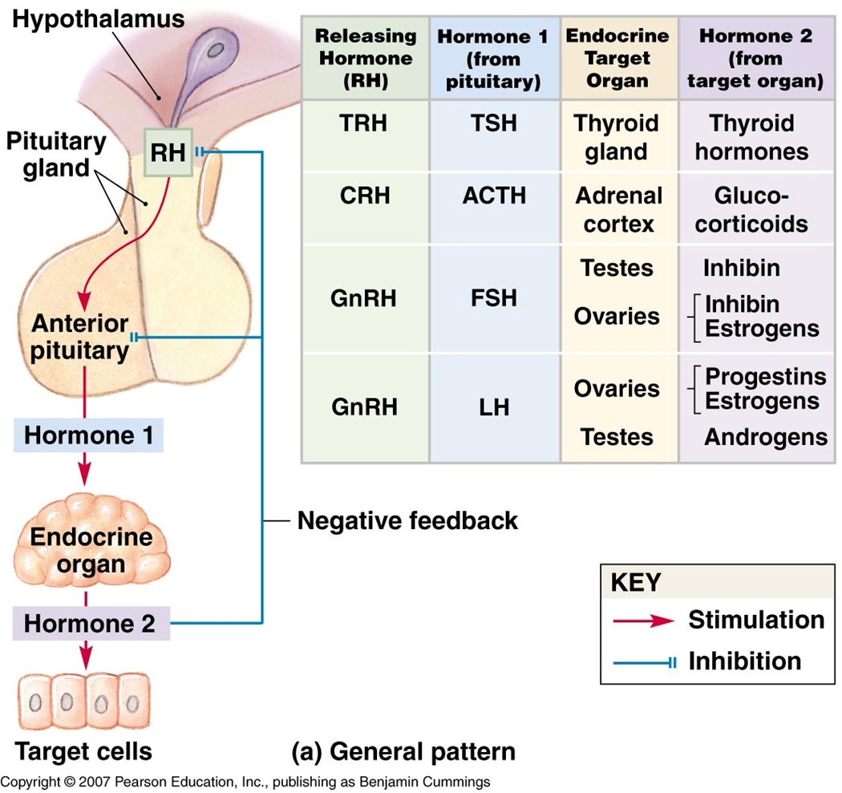
Feedback Control of the Anterior Pituitary
Anterior pituitary and hypothalamic secretions are controlled by the target organs they regulate.
Secretions are controlled by negative feedback inhibition by target gland hormones.
Negative feedback at 2 levels:
The target gland hormone can act on the hypothalamus and inhibit secretion of releasing hormones.
The target gland hormone can act on the anterior pituitary and inhibit response to the releasing hormone.

Slide 33
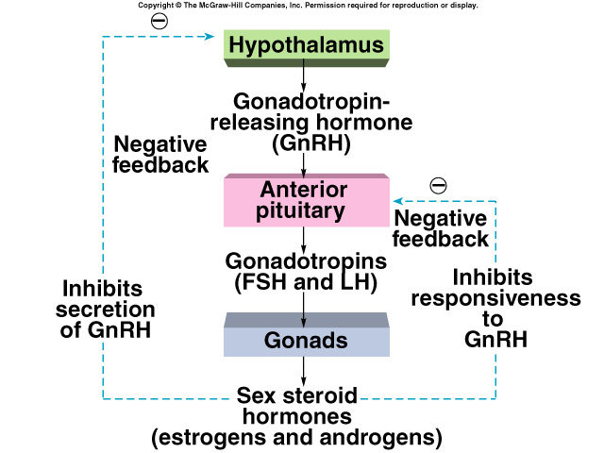
Feedback Control of the Anterior Pituitary (continued)
Short feedback loop:
Retrograde transport of blood from anterior pituitary to the hypothalamus.
Hormone released by anterior pituitary inhibits secretion of releasing hormone.
Positive feedback effect:
During the menstrual cycle, estrogen stimulates “LH surge.”

Slide 34
Higher Brain Function and Pituitary Secretion
Axis:
Relationship between anterior pituitary and a particular target gland.
Pituitary-gonad axis.
Hypothalamus receives input from higher brain centers.
Psychological stress affects:
Circadian rhythms.
Menstrual cycle.

Slide 35
Adrenal Glands
Paired organs that cap the kidneys.
Each gland consists of an outer cortex and inner medulla.
Adrenal medulla:
Derived from embryonic neural crest ectoderm (same tissue that produces the sympathetic ganglia).
Synthesizes and secretes:
Catecholamines (mainly Epi but some NE).

Slide 36
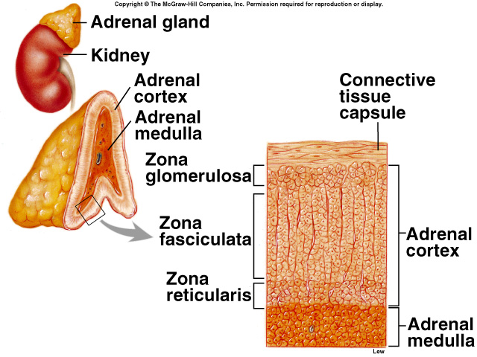
Adrenal Glands (continued)
Adrenal cortex:
Does not receive neural innervation.
Must be stimulated hormonally (ACTH).
Consists of 3 zones:
Zona glomerulosa.
Zona fasciculata.
Zona reticularis.
Secretes corticosteroids.

Slide 37
Functions of the Adrenal Cortex
Zona glomerulosa:
Mineralcorticoids (aldosterone):
Stimulate kidneys to reabsorb Na⁺ and secrete K⁺.
Zona fasciculata:
Glucocorticoids (cortisol):
Inhibit glucose utilization and stimulate gluconeogenesis.
Zona reticularis (DHEA):
Sex steroids:
Supplement sex steroids.
Notes:
Dehydroepiandrosterone,_DHEA

Slide 38
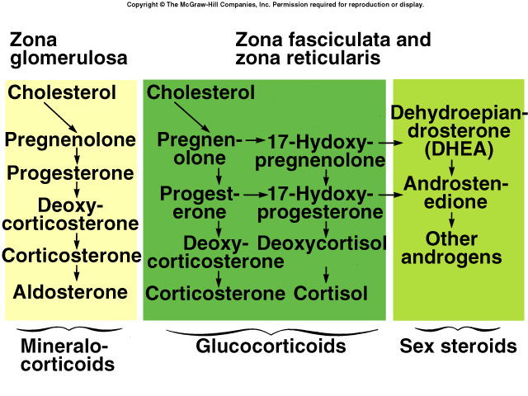
Functions of the Adrenal Cortex (continued)

Slide 39
Aldosterone, the main mineralocorticoid
Secreted by adrenal cortex in response to a decline in either blood volume or blood pressure (e.g. severe hemorrhage)
Is terminal hormone in renin-angiotensin mechanism
Prompts distal and collecting tubules in kidney to reabsorb more sodium
Water passively follows
Blood volume thus increases

Slide 40
Cortisol, the most important glucocorticoid (Glucocorticoid receptors are found in the cells of most vertebrate tissues)
It is essential for life
Helps the body deal with stressful situations within minutes
Physical: trauma, surgery, exercise
Psychological: anxiety, depression, crowding
Physiological: fasting, hypoglycemia, fever, infection
Regulates or supports a variety of important cardiovascular, metabolic, immunologic, and homeostatic functions including water balance
People with adrenal insufficiency: these stresses can cause hypotension, shock and death: must give glucocorticoids, eg for surgery or if have infection, etc.

Slide 41
Cortisol continued
Keeps blood glucose levels high enough to support brain’s activity
Forces other body cells to switch to fats and amino acids as energy sources
Catabolic: break down protein
Redirects circulating lymphocytes to lymphoid and peripheral tissues where pathogens usually are accumulated
In large quantities, depresses immune and inflammatory response
Used therapeutically
Responsible for some of its side effects

Slide 42
Functions of the Adrenal Medulla
Adrenal medulla
Part of autonomic nervous system
Spherical chromaffin cells are modified postganglionic sympathetic neurons
Secrete epinephrine and norepinephrine
Amine hormones
Fight, flight, fright
Vesicles store the hormones
Innervated by preganglionic sympathetic axons.
Increase respiratory rate.
Increase HR and cardiac output.
Vasoconstrict blood vessels, thus increasing venous return.
Stimulate glycogenolysis.
Stimulate lipolysis.

Slide 43
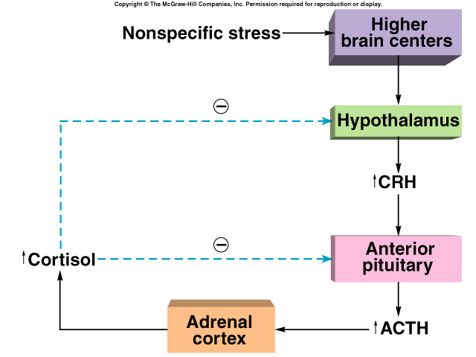
Hormonal stimulation of glucocorticoids HPA axis (hypothalamic/pituitary/adrenal axis)
With stress, hypothalamus sends CRH to anterior pituitary (adenohypophysis)
Pituitary secretes ACTH
ACTH goes to adrenal cortex where stimulates glucocorticoid secretion
Sympathetic nervous system can also stimulate it
Adrenal cortex also secretes DHEA (dehydroepiandrosterone)
Converted in peripheral tissues to testosterone and estrogen (also steroid hormones)
Unclear function in relation to stress
Notes:
hypothalamic–pituitary–adrenal axis (HPA axis or HTPA axis)

Slide 44
Stress and the Adrenal Gland
Non-specific response to stress produces the general adaptation syndrome (GAS).
Alarm phase:
Adrenal glands activated.
Stage of resistance:
Stage of readjustment.
Stage of exhaustion:
Sickness and/or death if readjustment is not complete.

Slide 45
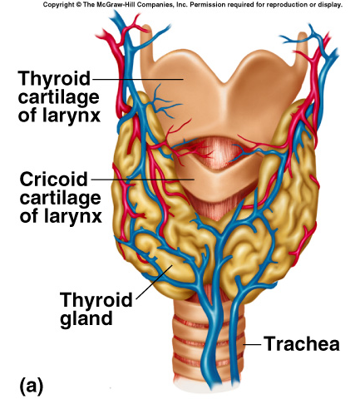
Thyroid Hormones
Thyroid gland is located just below the larynx.
Thyroid is the largest of the pure endocrine glands.
Follicular cells secrete thyroxine.
Parafollicular cells secrete calcitonin.

Slide 46
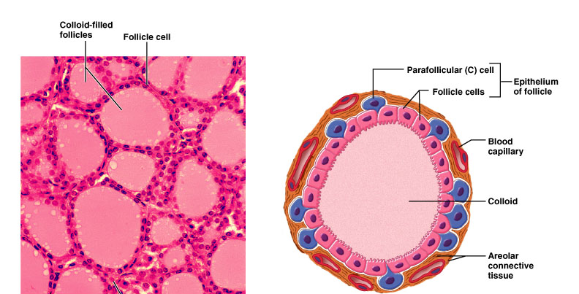
Thyroid is composed of spherical follicles
Follicle cells: produce thyroglobulin, the precursor of thryoid hormone (thyroxin)
Colloid lumen is of thyroglobulin
Parafollicular “C” cells: produce calcitonin

Slide 47
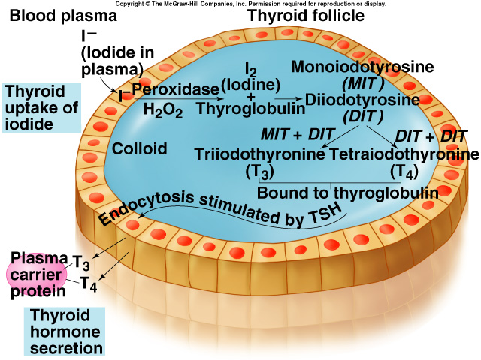
Production of Thyroid Hormones
Iodide (I⁻) actively transported into the follicle and secreted into the colloid.
Oxidized to iodine (Iº).
Iodine attached to tyrosine within thyroglobulin chain.
Attachment of 1 iodine produces monoiodotyrosine (MIT).
Attachment of 2 iodines produces diiodotyrosine (DIT).
MIT and DIT or 2 DIT molecules coupled together.

Slide 48
Production of Thyroid Hormones (continued)
T₃ and T₄ produced.
TSH stimulates pinocytosis into the follicular cell.
Enzymes hydrolyze T₃ and T₄ from thyroglobulin.
Attached to TBG and released into blood.
Notes:
Thyroxine-binding globulin (TBG)

Slide 49
Actions of T₃
Stimulates protein synthesis.
Promotes maturation of nervous system.
Stimulates rate of cellular respiration by:
Production of uncoupling proteins.
Increase active transport by Na⁺/K⁺ pumps.
Lower cellular [ATP].
Increases metabolic heat.
Increases metabolic rate.
Stimulates increased consumption of glucose, fatty acids and other molecules.

Slide 50
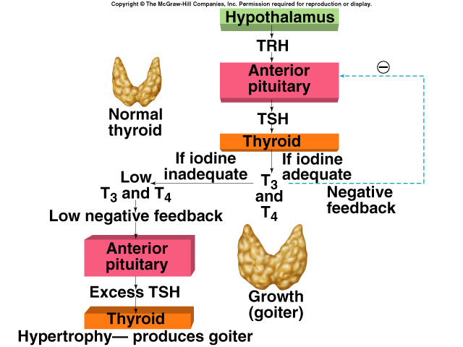
Diseases of the Thyroid
Iodine-deficiency (endemic) goiter:
Abnormal growth of the thyroid gland.
In the absence of sufficient iodine, cannot produce adequate amounts of T₄ and T₃.
Lack of negative feedback inhibition.
Stimulates TSH, which causes abnormal growth.

Slide 51
Diseases of the Thyroid (continued)
[Iodine-deficiency (endemic) goiter—continued]
Adult myxedema:
Accumulation of mucoproteins and fluid in subcutaneous tissue.
Symptoms:
Decreased metabolic rate.
Weight gain.
Decreased ability to adapt to cold.
Lethargy.
Grave’s disease:
Autoimmune disorder:
Exerts TSH-like effects on thyroid.
Not affected by negative feedback.
Cretinism:
Hypothyroid from end of 1st trimester to 6 months postnatally.
Severe mental retardation.

Slide 52
The Thyroid Gland
Function of the C Cells of the Thyroid Gland
Secrete calcitonin
Lowers blood Ca²⁺ levels
Increases urinary calcium loss
Caused by high blood Ca²⁺ level

Slide 53
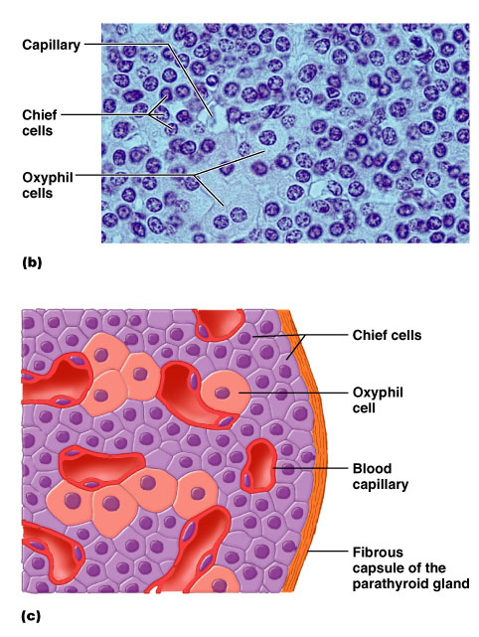
The Parathyroid Glands
(two types of cells)
Rare chief cells
Abundant oxyphil cells (unknown function)
Chief cells produce PTH
Parathyroid hormone, or parathormone
A small protein hormone
Low blood Ca²⁺ triggers secretion
PTH raises blood Ca²⁺

Slide 54
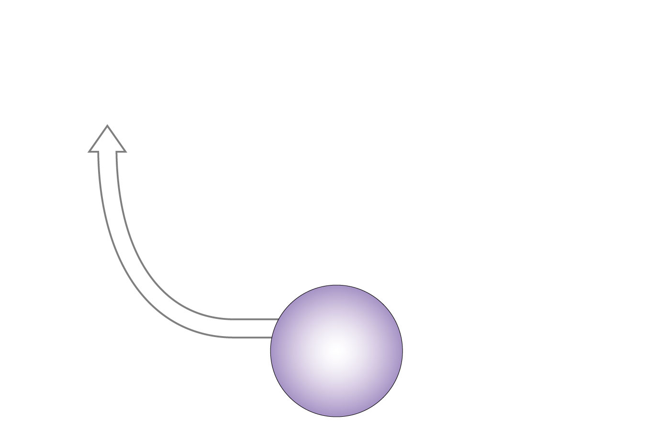
HOMEOSTASIS
DISTURBED
Rising calcium
levels in blood
HOMEOSTASIS
Normal calcium
levels
(8.5-11 mg/dl)

Slide 55
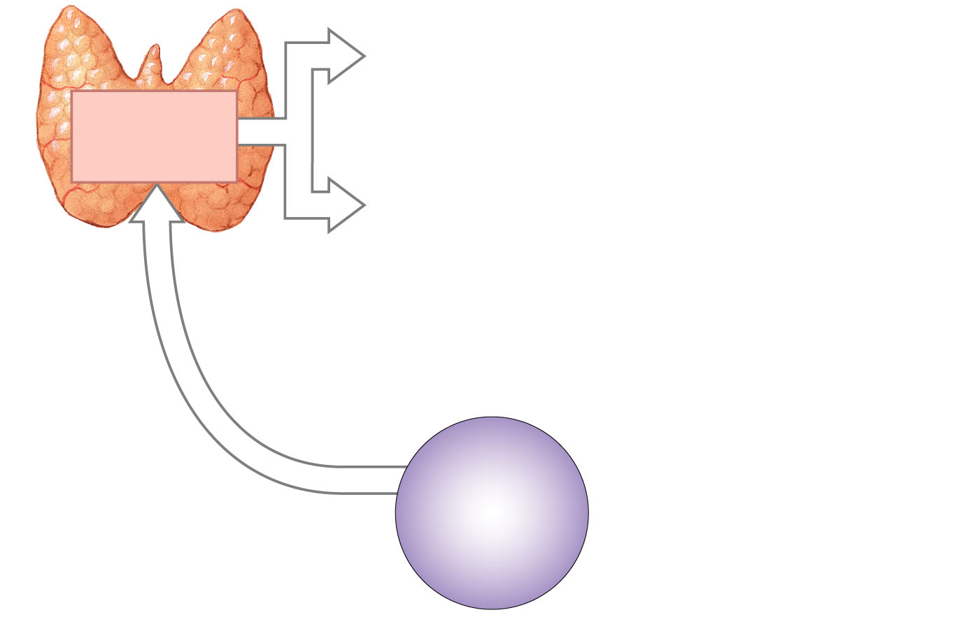
Thyroid gland
produces
calcitonin
HOMEOSTASIS
DISTURBED
Rising calcium
levels in blood
HOMEOSTASIS
Normal calcium
levels
(8.5-11 mg/dl)
Figure 10-10
3 of 13

Slide 56
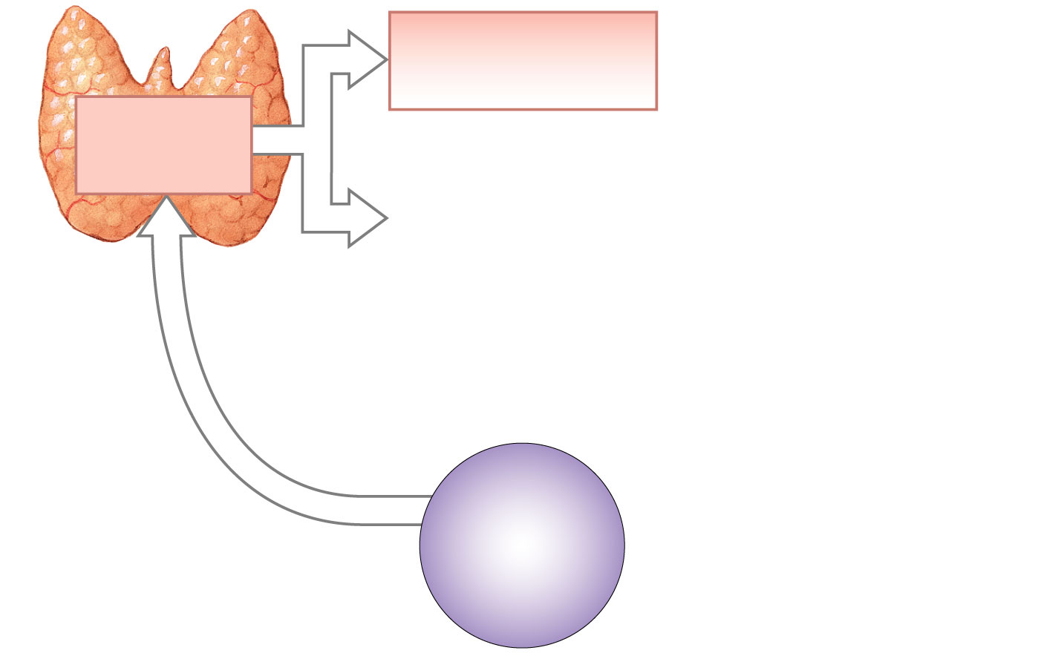
Increased excretion
of calcium
in kidneys
Thyroid gland
produces
calcitonin
HOMEOSTASIS
DISTURBED
Rising calcium
levels in blood
HOMEOSTASIS
Normal calcium
levels
(8.5-11 mg/dl)

Slide 57
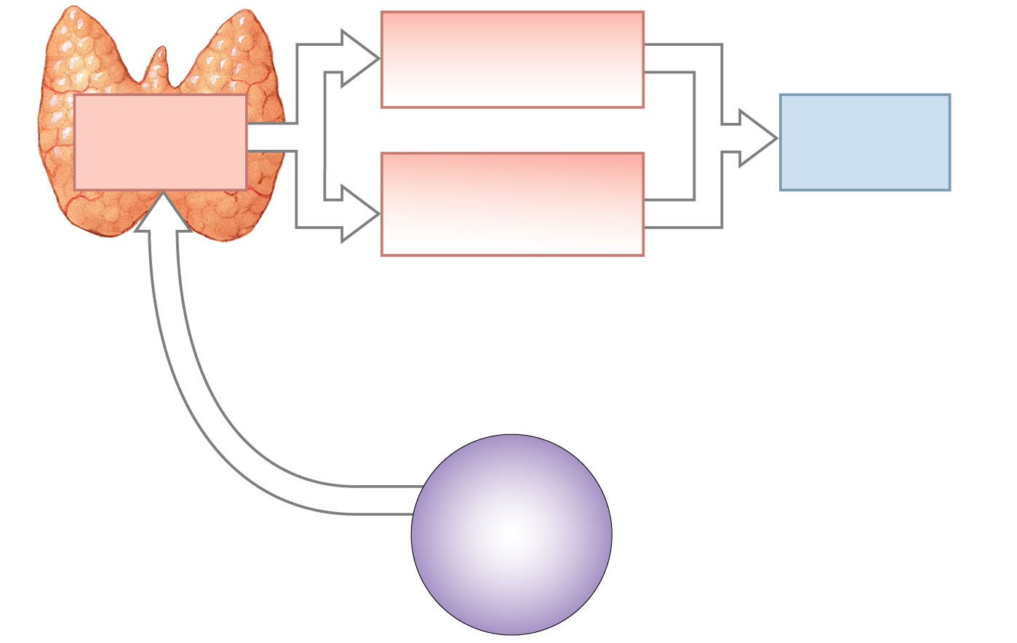
Increased excretion
of calcium
in kidneys
Thyroid gland
produces
calcitonin
Blood calcium
levels decline
Calcium deposition in
bone (inhibition
of osteoclasts)
HOMEOSTASIS
DISTURBED
Rising calcium
levels in blood
HOMEOSTASIS
Normal calcium
levels
(8.5-11 mg/dl)

Slide 58
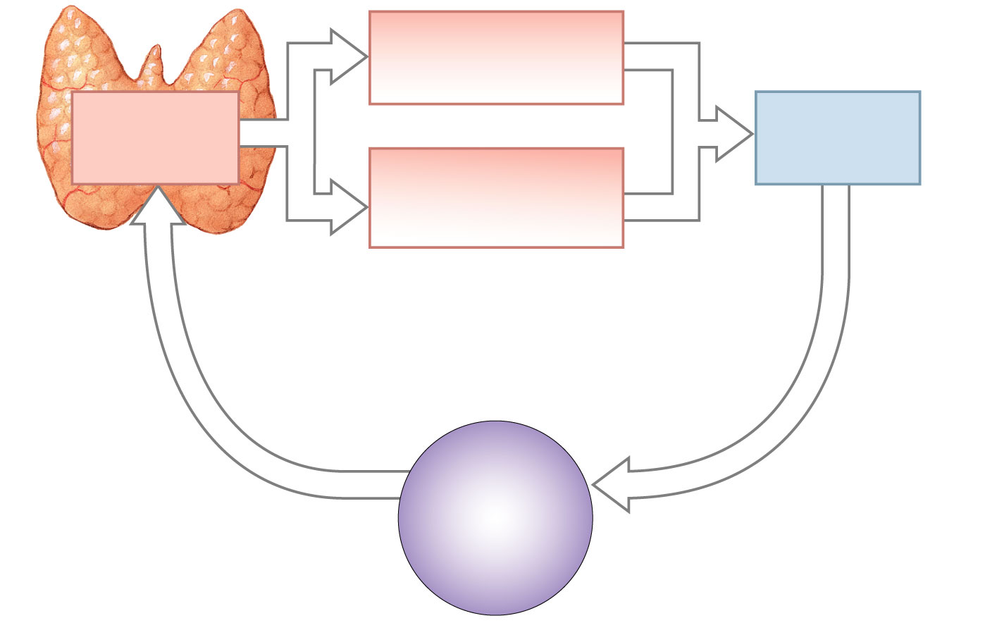
Increased excretion
of calcium
in kidneys
Thyroid gland
produces
calcitonin
Blood calcium
levels decline
Calcium deposition in
bone (inhibition
of osteoclasts)
Uncertain significance
in a healthy
nonpregnant adult
HOMEOSTASIS
DISTURBED
HOMEOSTASIS
RESTORED
Rising calcium
levels in blood
HOMEOSTASIS
Normal calcium
levels
(8.5-11 mg/dl)

Slide 59
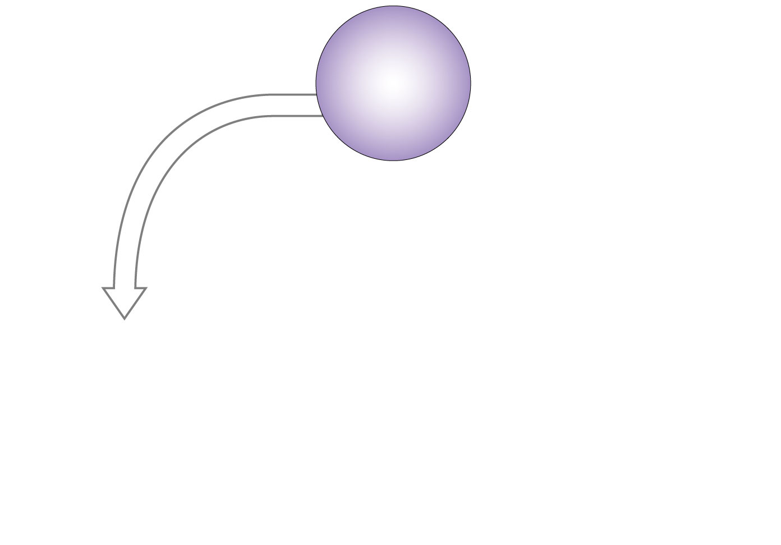
HOMEOSTASIS
Normal calcium
levels
(8.5-11 mg/dl)
HOMEOSTASIS
DISTURBED
Falling calcium
levels in blood

Slide 60
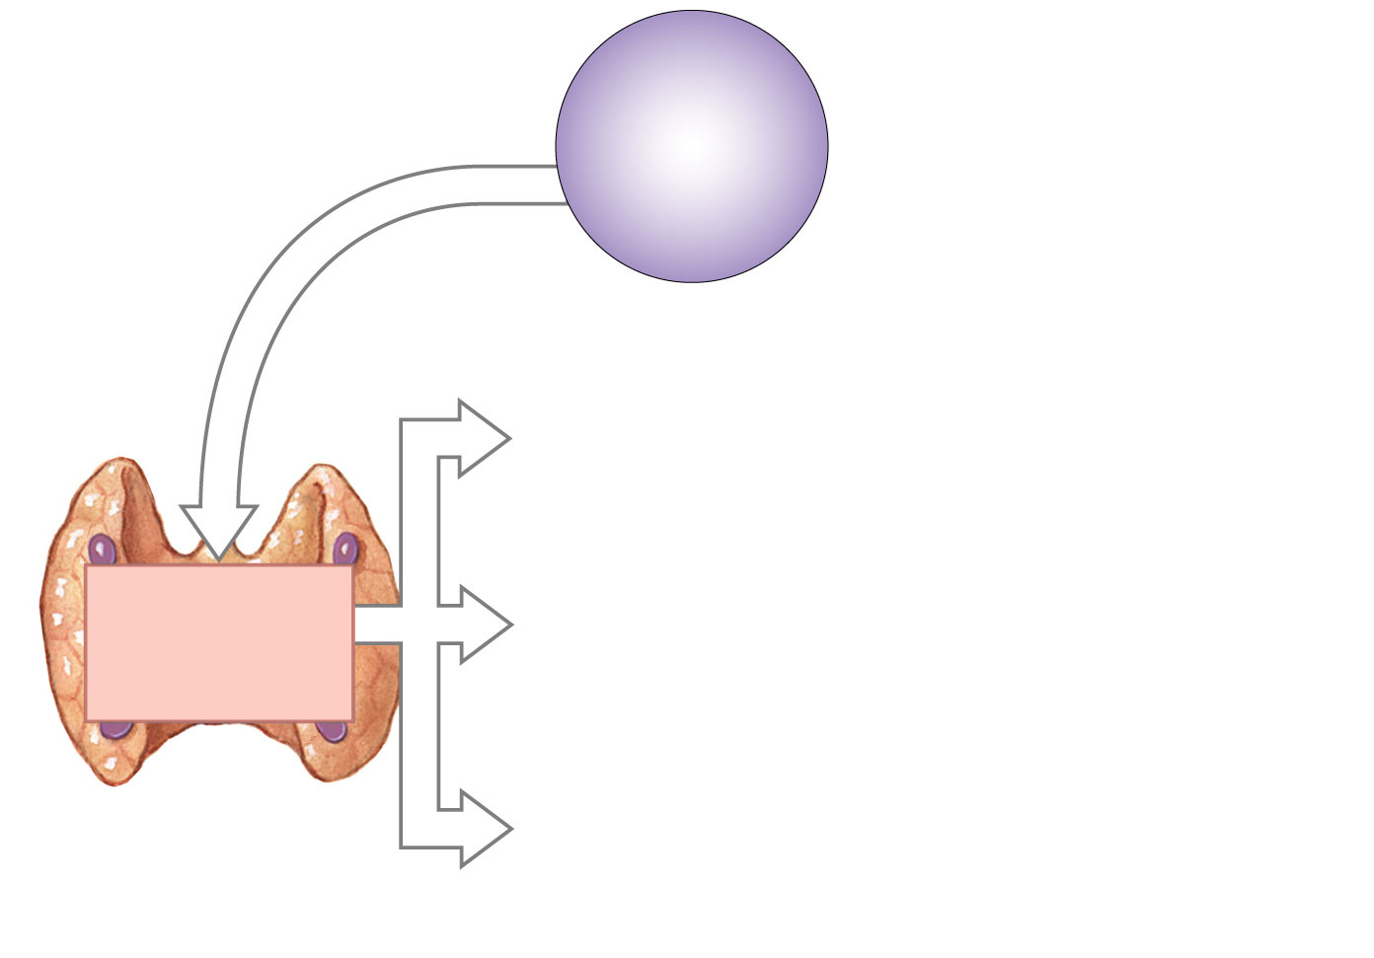
HOMEOSTASIS
Normal calcium
levels
(8.5-11 mg/dl)
HOMEOSTASIS
DISTURBED
Falling calcium
levels in blood
Parathyroid
glands secrete
parathyroid
hormone (PTH)

Slide 61
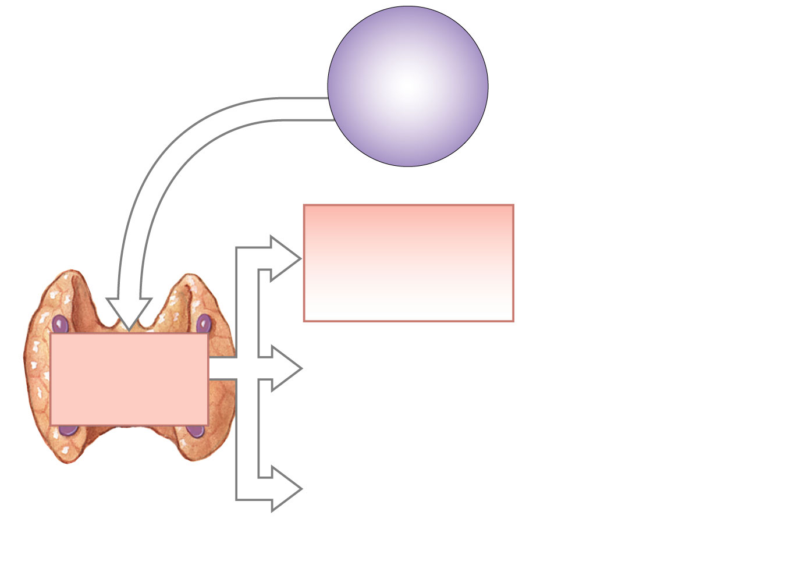
HOMEOSTASIS
Normal calcium
levels
(8.5-11 mg/dl)
HOMEOSTASIS
DISTURBED
Falling calcium
levels in blood
Release of stored
calcium from bone
(stimulation of
osteoclasts, inhibition
of osteoblasts)
Parathyroid
glands secrete
parathyroid
hormone (PTH)

Slide 62
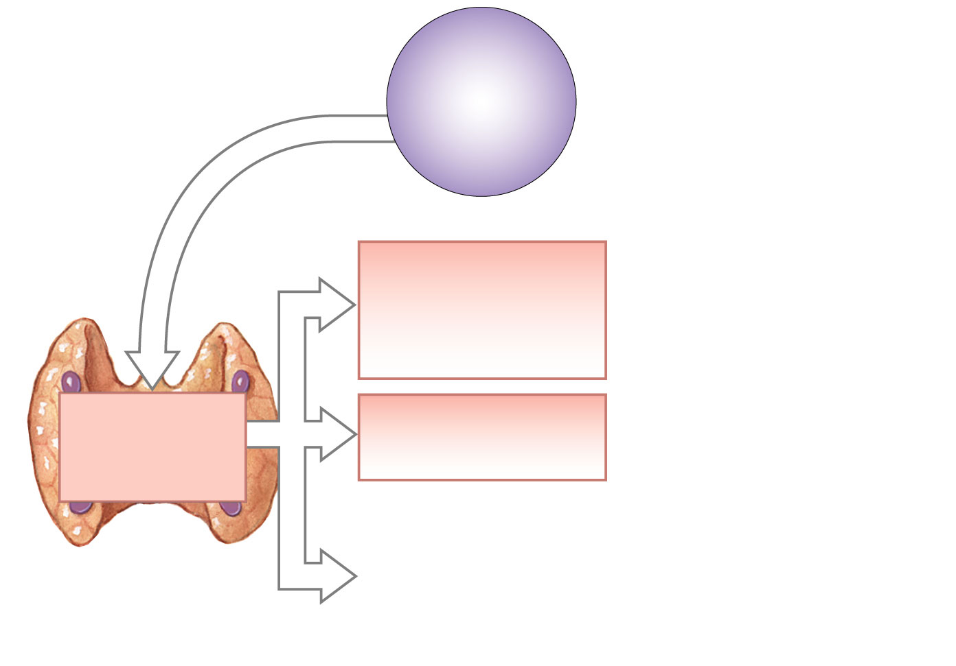
HOMEOSTASIS
Normal calcium
levels
(8.5-11 mg/dl)
HOMEOSTASIS
DISTURBED
Falling calcium
levels in blood
Release of stored
calcium from bone
(stimulation of
osteoclasts, inhibition
of osteoblasts)
Parathyroid
glands secrete
parathyroid
hormone (PTH)
Enhanced
reabsorption
of calcium in kidneys

Slide 63
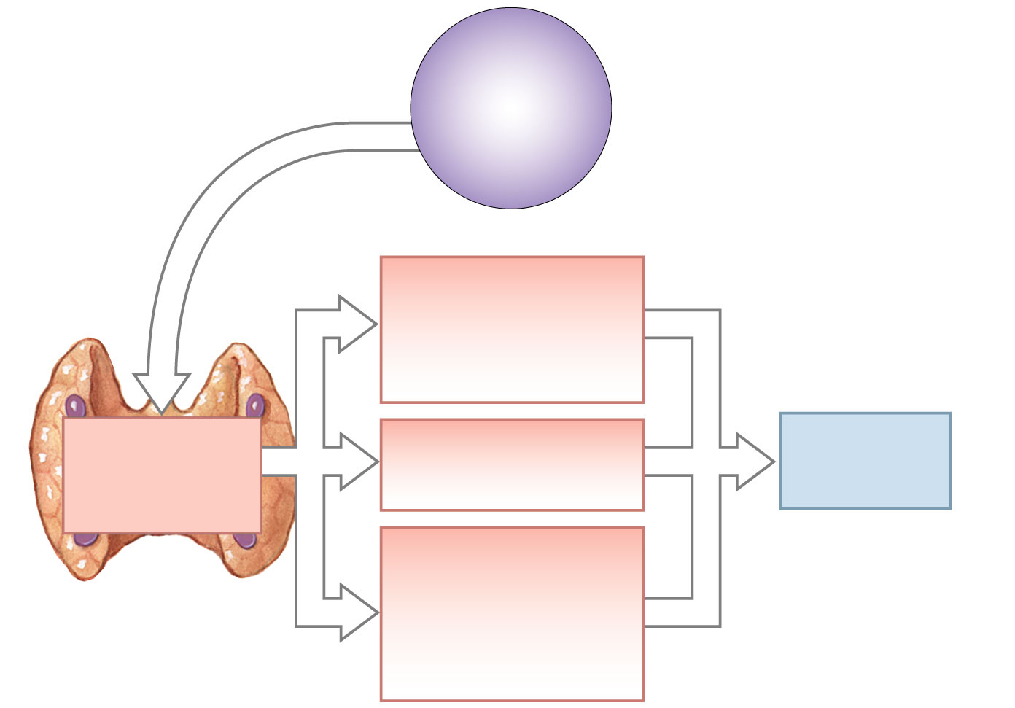
HOMEOSTASIS
Normal calcium
levels
(8.5-11 mg/dl)
HOMEOSTASIS
DISTURBED
Falling calcium
levels in blood
Release of stored
calcium from bone
(stimulation of
osteoclasts, inhibition
of osteoblasts)
Parathyroid
glands secrete
parathyroid
hormone (PTH)
Enhanced
reabsorption
of calcium in kidneys
Blood calcium
levels
increase
Stimulation of
calcitriol production
at kidneys;
enhanced Ca²⁺, PO₄³⁻
absorption by
digestive tract

Slide 64
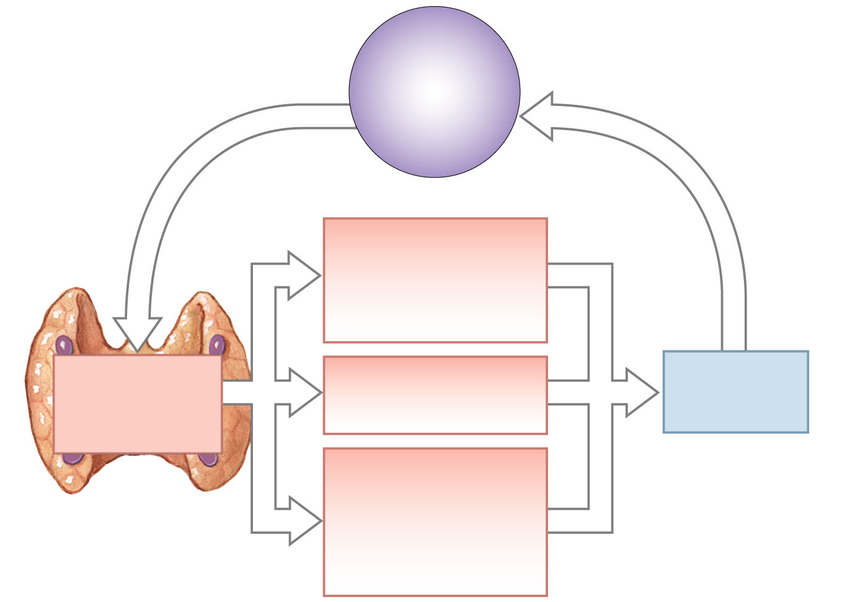
HOMEOSTASIS
Normal calcium
levels
(8.5-11 mg/dl)
HOMEOSTASIS
DISTURBED
HOMEOSTASIS
RESTORED
Falling calcium
levels in blood
Release of stored
calcium from bone
(stimulation of
osteoclasts, inhibition
of osteoblasts)
Parathyroid
glands secrete
parathyroid
hormone (PTH)
Enhanced
reabsorption
of calcium in kidneys
Blood calcium
levels
increase
Stimulation of
calcitriol production
at kidneys;
enhanced Ca²⁺, PO₄³⁻
absorption by
digestive tract

Slide 65
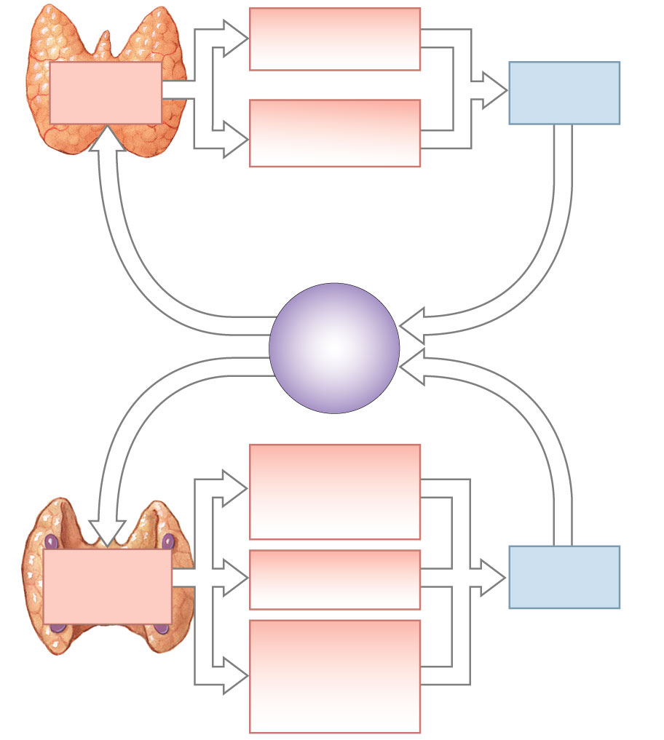
Increased excretion
of calcium
in kidneys
Thyroid gland
produces
calcitonin
Blood calcium
levels decline
Calcium deposition in
bone (inhibition
of osteoclasts)
Uncertain significance
in a healthy
nonpregnant adult
HOMEOSTASIS
DISTURBED
HOMEOSTASIS
RESTORED
Rising calcium
levels in blood
HOMEOSTASIS
Normal calcium
levels
(8.5-11 mg/dl)
HOMEOSTASIS
DISTURBED
HOMEOSTASIS
RESTORED
Falling calcium
levels in blood
Release of stored
calcium from bone
(stimulation of
osteoclasts, inhibition
of osteoblasts)
Parathyroid
glands secrete
parathyroid
hormone (PTH)
Enhanced
reabsorption
of calcium in kidneys
Blood calcium
levels
increase
Stimulation of
calcitriol production
at kidneys;
enhanced Ca²⁺, PO₄³⁻
absorption by
digestive tract

Slide 66
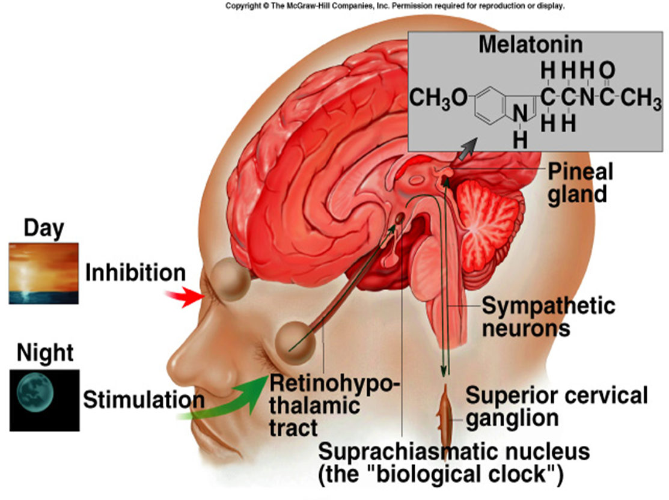
Pineal Gland
Secretes melatonin:
Production stimulated by the suprachiasmatic nucleus (SCN) in hypothalamus.
SCN is primary center for circadian rhythms.
Light/dark changes required to synchronize.
Melatonin secretion increases with darkness and peaks in middle of night.
May inhibit GnRH.
May function in the onset of puberty (controversial).

Slide 67
The Pancreas
Lies behind stomach and beneath liver
Endocrine cells organized into islets of Langerhans
Islet cells secrete insulin and glucagon

Slide 68
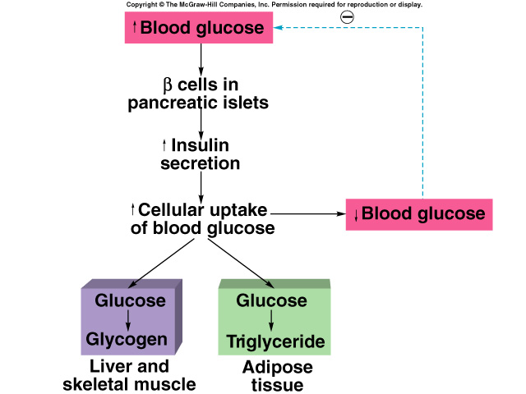
Pancreatic Islets (Islets of Langerhans)
Alpha cells secrete glucagon.
Stimulus is decrease in blood [glucose].
Stimulates glycogenolysis and lipolysis.
Stimulates conversion of fatty acids to ketones.
Beta cells secrete insulin.
Stimulus is increase in blood [glucose].
Promotes entry of glucose into cells.
Converts glucose to glycogen and fat.
Aids entry of amino acids into cells.

Slide 69
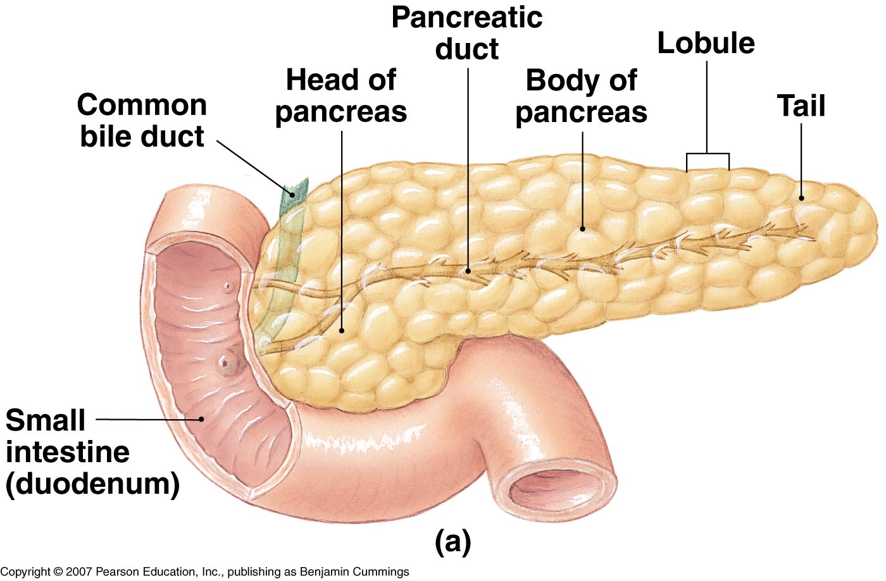
The Pancreas
The Endocrine Pancreas

Slide 70
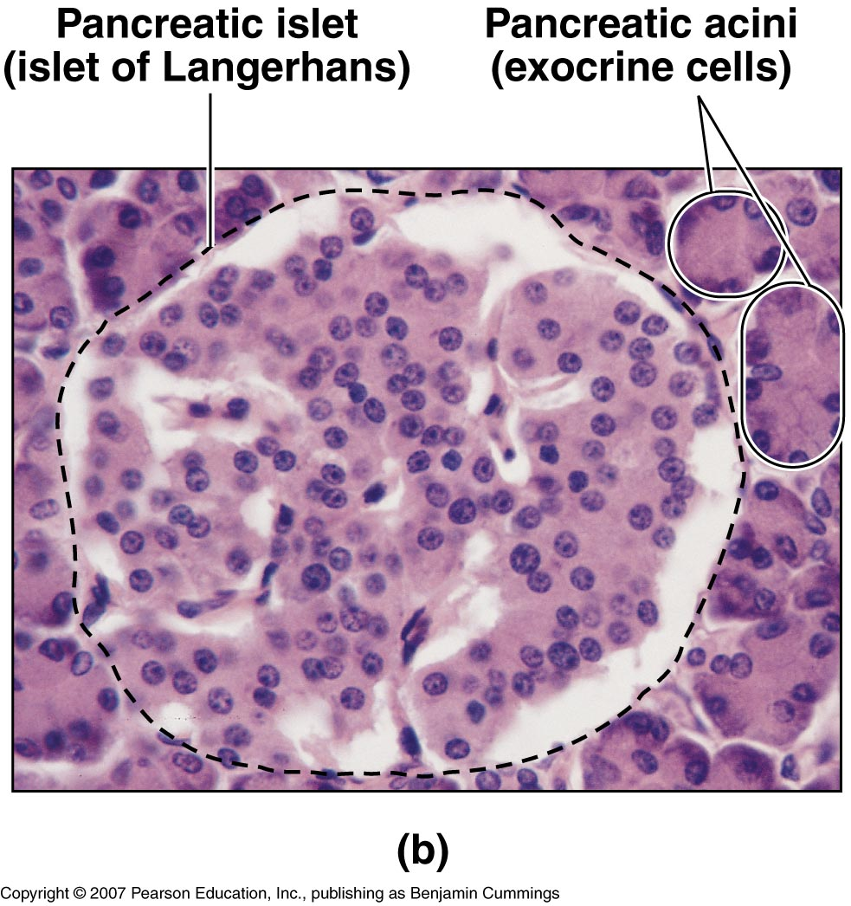
The Pancreas
The Endocrine Pancreas

Slide 71
The Pancreas
of Insulin and Glucagon.
Insulin
Lowers blood glucose concentration
Glucagon
Raises blood glucose concentration

Slide 72
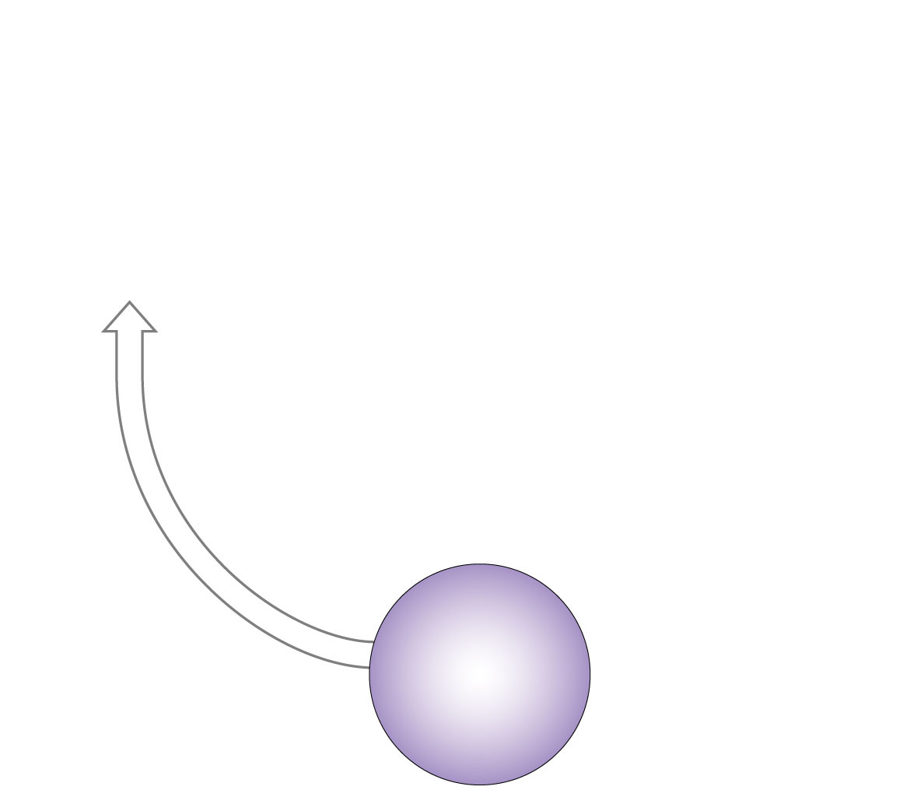
HOMEOSTASIS
DISTURBED
Rising blood
glucose levels
HOMEOSTASIS
Normal glucose
levels
(70-110 mg/dl)

Slide 73
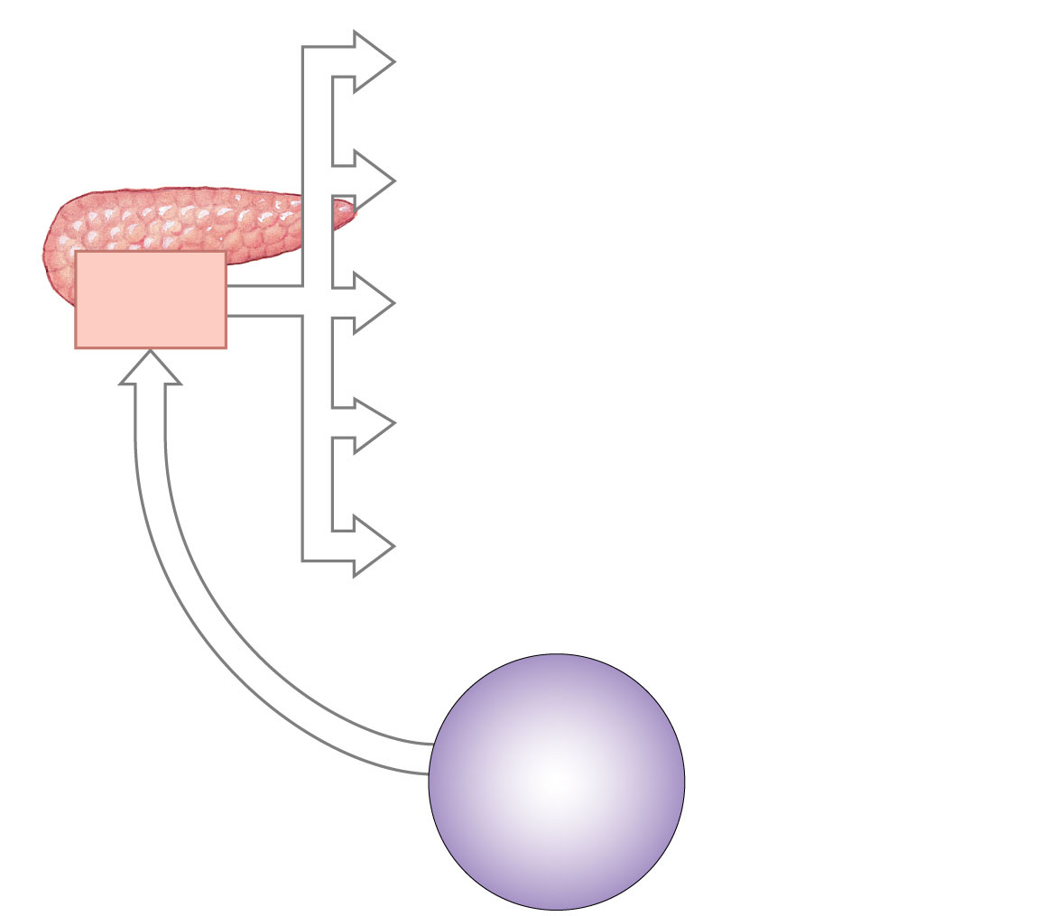
Beta cells
secrete
insulin
HOMEOSTASIS
DISTURBED
Rising blood
glucose levels
HOMEOSTASIS
Normal glucose
levels
(70-110 mg/dl)

Slide 74
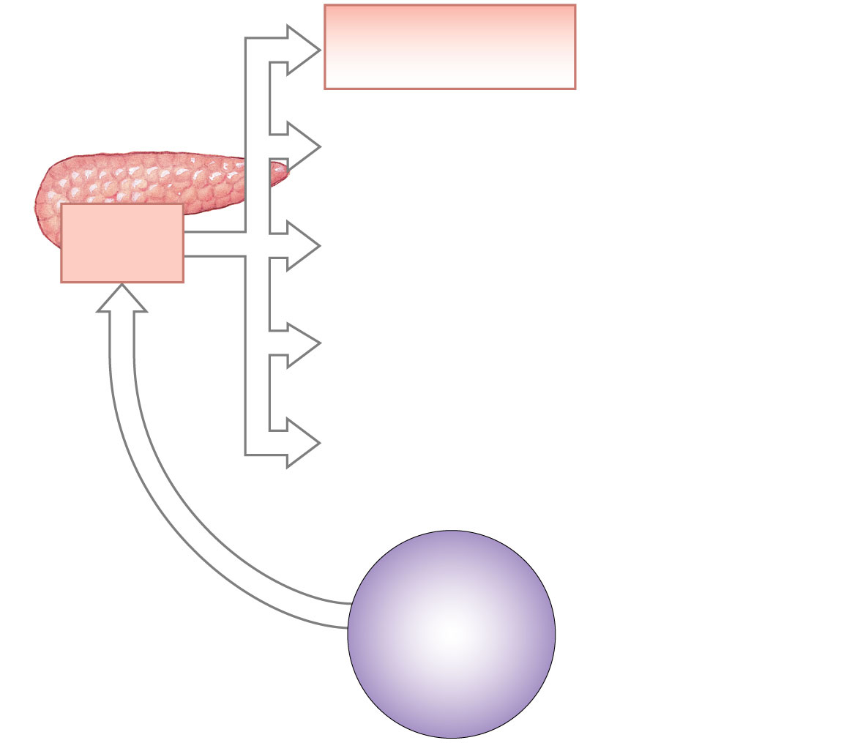
Increased rate of
glucose transport
into target cell
Beta cells
secrete
insulin
HOMEOSTASIS
DISTURBED
Rising blood
glucose levels
HOMEOSTASIS
Normal glucose
levels
(70-110 mg/dl)

Slide 75
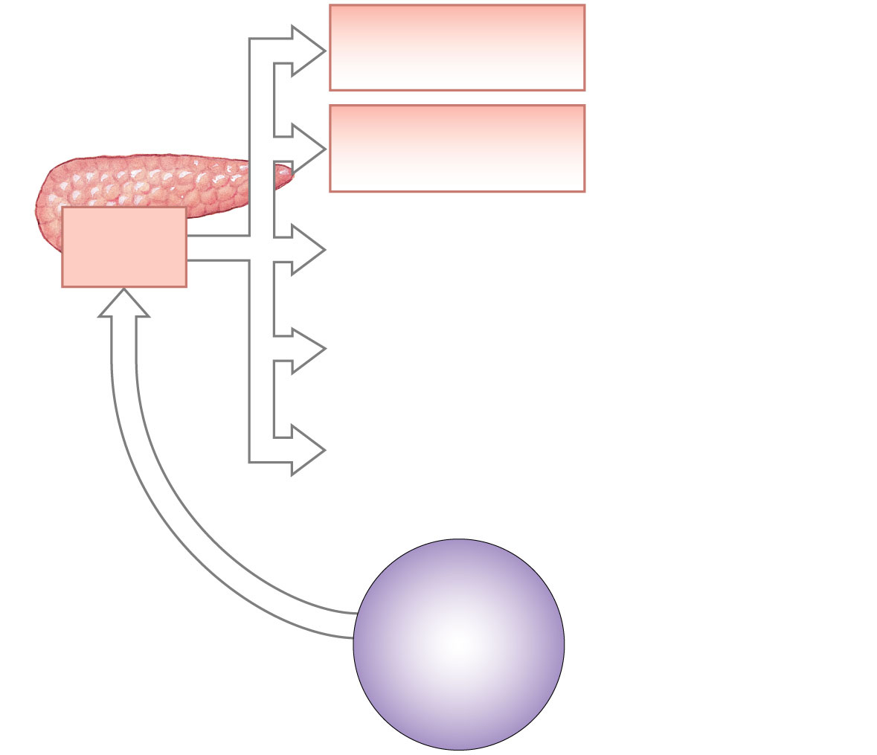
Increased rate of
glucose transport
into target cell
Increased rate of
glucose utilization
and ATP generation
Beta cells
secrete
insulin
HOMEOSTASIS
DISTURBED
Rising blood
glucose levels
HOMEOSTASIS
Normal glucose
levels
(70-110 mg/dl)

Slide 76
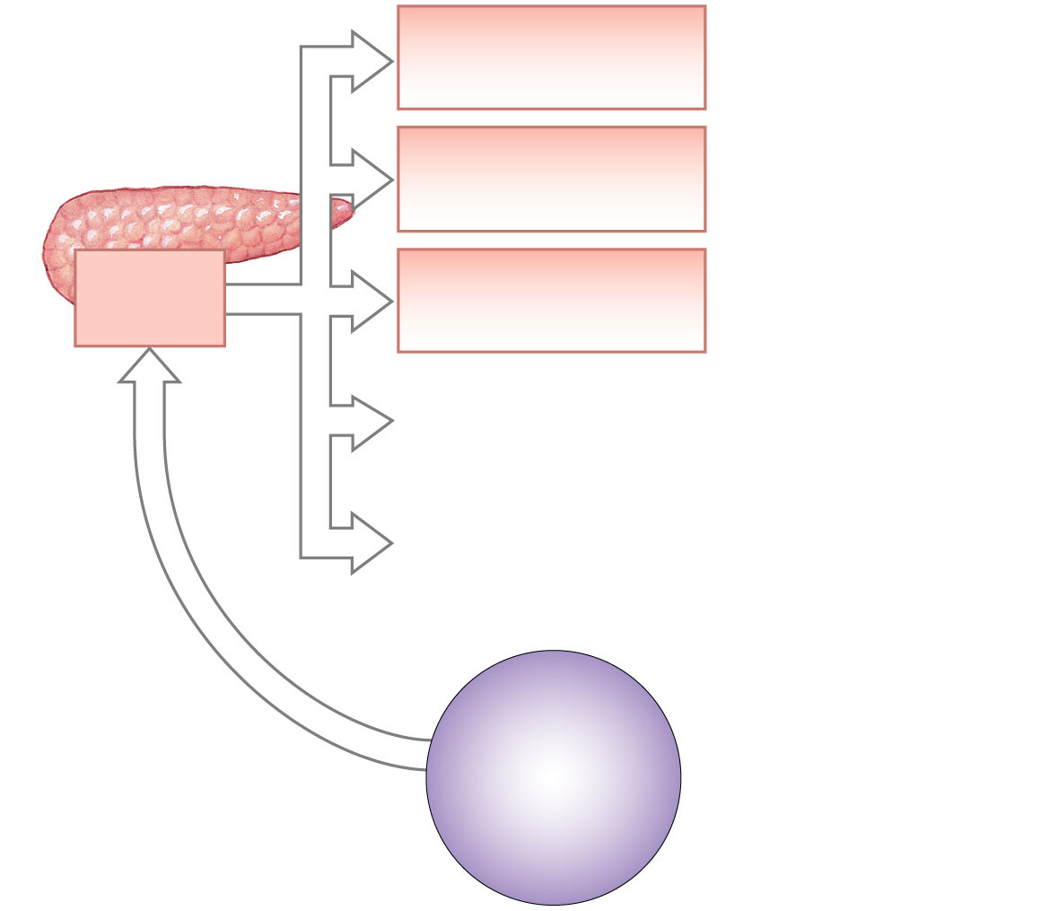
Increased rate of
glucose transport
into target cell
Increased rate of
glucose utilization
and ATP generation
Beta cells
secrete
insulin
Increased conversion
of glucose to glycogen
(liver, skeletal muscle)
HOMEOSTASIS
DISTURBED
Rising blood
glucose levels
HOMEOSTASIS
Normal glucose
levels
(70-110 mg/dl)

Slide 77
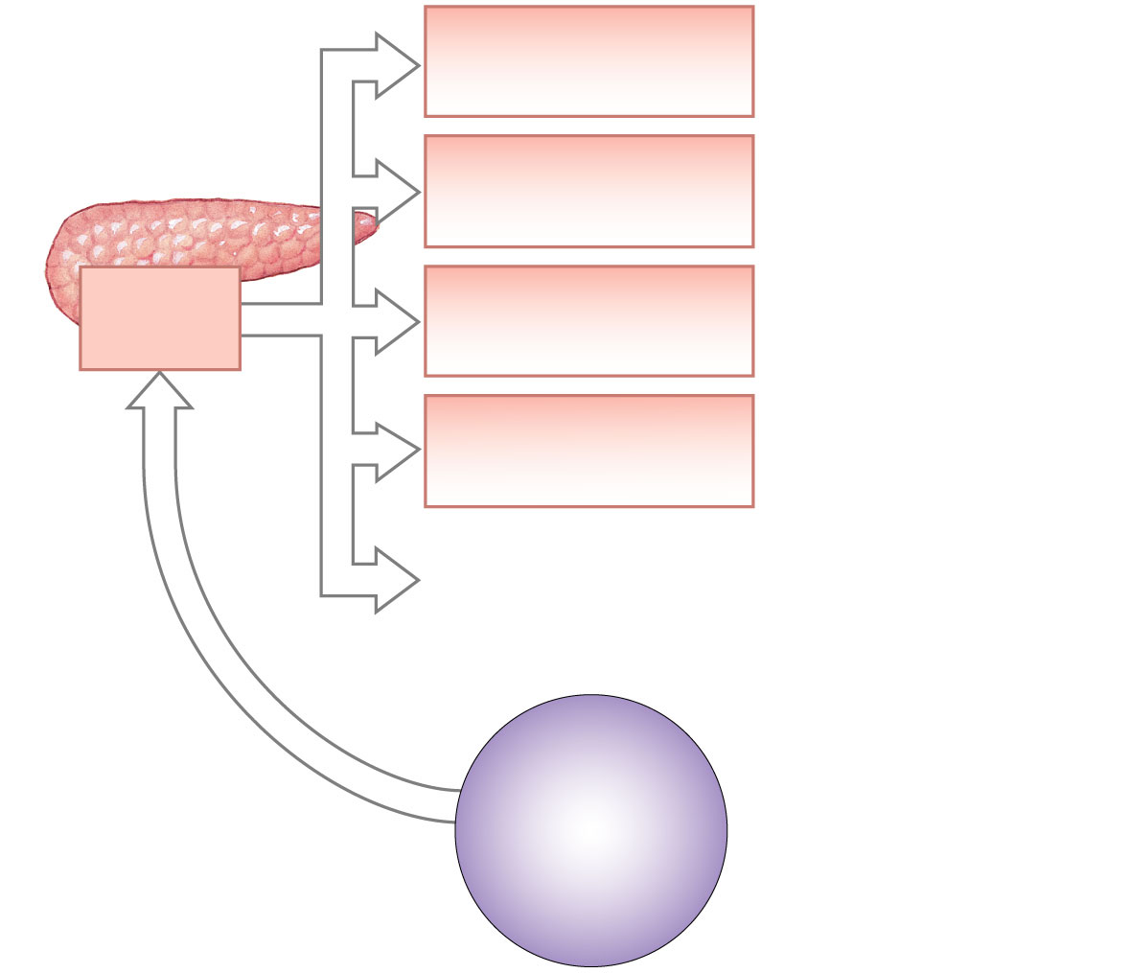
Increased rate of
glucose transport
into target cell
Increased rate of
glucose utilization
and ATP generation
Beta cells
secrete
insulin
Increased conversion
of glucose to glycogen
(liver, skeletal muscle)
Increased amino acid
absorption and
protein synthesis
HOMEOSTASIS
DISTURBED
Rising blood
glucose levels
HOMEOSTASIS
Normal glucose
levels
(70-110 mg/dl)

Slide 78
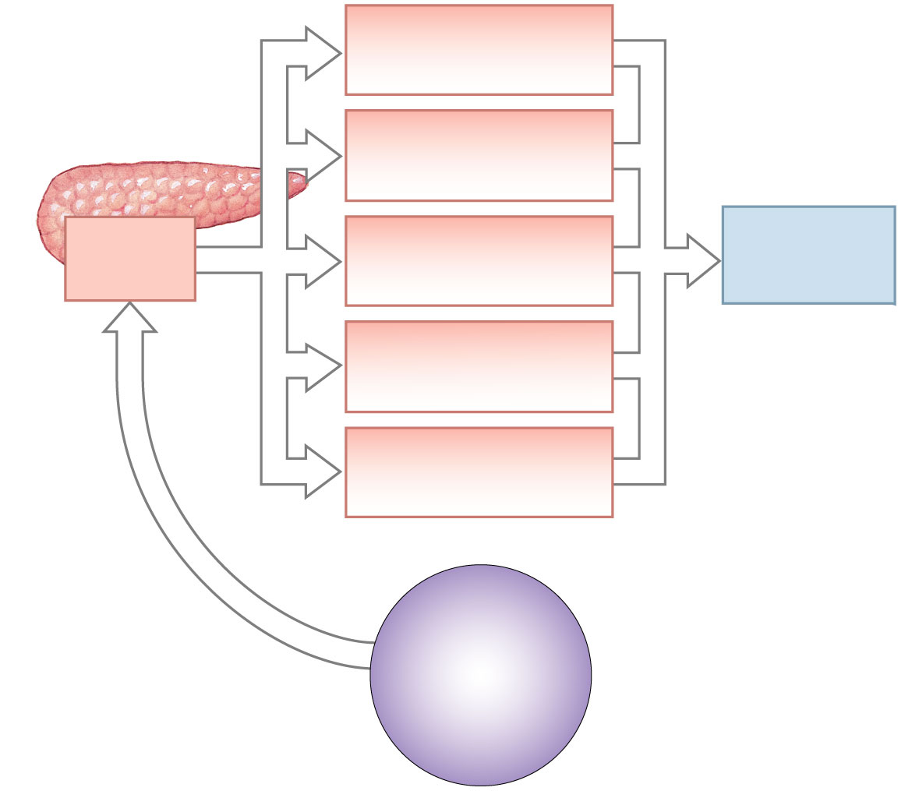
Increased rate of
glucose transport
into target cell
Increased rate of
glucose utilization
and ATP generation
Beta cells
secrete
insulin
Increased conversion
of glucose to glycogen
(liver, skeletal muscle)
Blood glucose
concentration
declines
Increased amino acid
absorption and
protein synthesis
Increased fat
synthesis
(adipose tissue)
HOMEOSTASIS
DISTURBED
Rising blood
glucose levels
HOMEOSTASIS
Normal glucose
levels
(70-110 mg/dl)

Slide 79
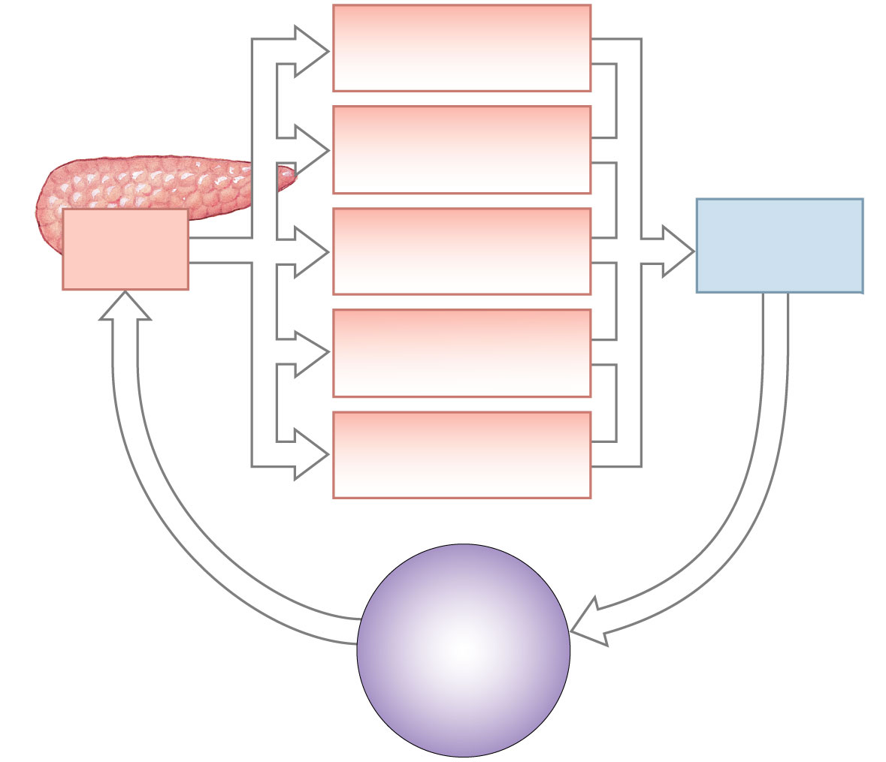
Increased rate of
glucose transport
into target cell
Increased rate of
glucose utilization
and ATP generation
Beta cells
secrete
insulin
Increased conversion
of glucose to glycogen
(liver, skeletal muscle)
Blood glucose
concentration
declines
Increased amino acid
absorption and
protein synthesis
Increased fat
synthesis
(adipose tissue)
HOMEOSTASIS
DISTURBED
Rising blood
glucose levels
HOMEOSTASIS
RESTORED
HOMEOSTASIS
Normal glucose
levels
(70-110 mg/dl)

Slide 80
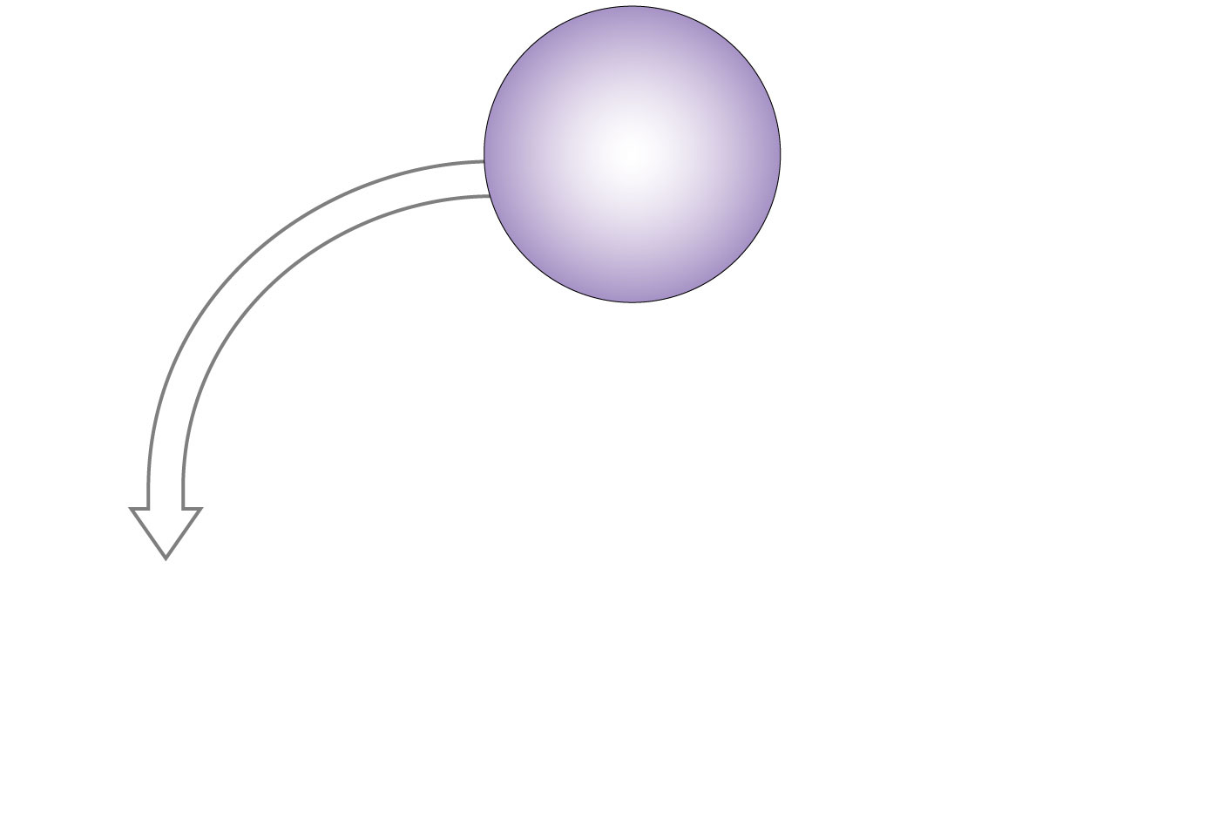
HOMEOSTASIS
Normal glucose
levels
(70-110 mg/dl)
HOMEOSTASIS
DISTURBED
Declining blood
glucose levels

Slide 81
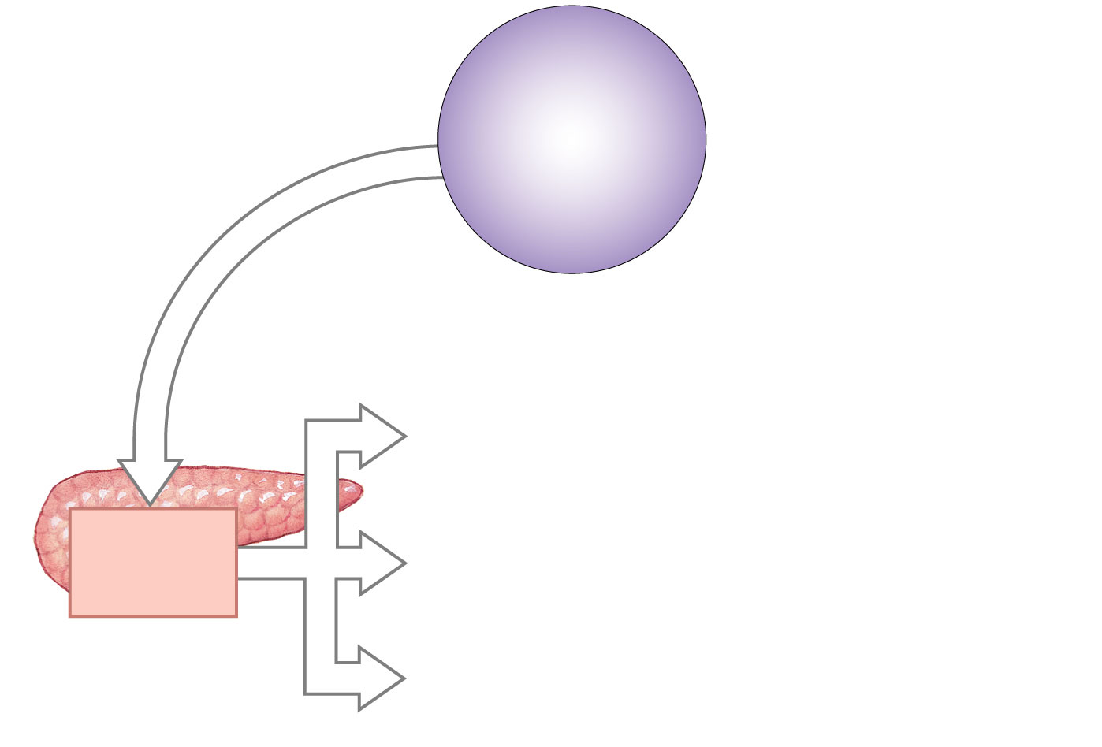
HOMEOSTASIS
Normal glucose
levels
(70-110 mg/dl)
HOMEOSTASIS
DISTURBED
Declining blood
glucose levels
Alpha cells
secrete
glucagon

Slide 82
HOMEOSTASIS
Normal glucose
levels
(70-110 mg/dl)
HOMEOSTASIS
DISTURBED
Declining blood
glucose levels
Increased breakdown
of glycogen to glucose
(liver, skeletal muscle)
Alpha cells
secrete
glucagon

Slide 83
HOMEOSTASIS
Normal glucose
levels
(70-110 mg/dl)
HOMEOSTASIS
DISTURBED
Declining blood
glucose levels
Increased breakdown
of glycogen to glucose
(liver, skeletal muscle)
Alpha cells
secrete
glucagon
Increased breakdown
of fats to fatty acids
(adipose tissue)

Slide 84
HOMEOSTASIS
Normal glucose
levels
(70-110 mg/dl)
HOMEOSTASIS
DISTURBED
Declining blood
glucose levels
Increased breakdown
of glycogen to glucose
(liver, skeletal muscle)
Alpha cells
secrete
glucagon
Increased breakdown
of fats to fatty acids
(adipose tissue)
Blood glucose
concentration
rises
Increased synthesis
and release of
glucose (liver)

Slide 85
HOMEOSTASIS
Normal glucose
levels
(70-110 mg/dl)
HOMEOSTASIS
DISTURBED
Declining blood
glucose levels
HOMEOSTASIS
RESTORED
Increased breakdown
of glycogen to glucose
(liver, skeletal muscle)
Alpha cells
secrete
glucagon
Increased breakdown
of fats to fatty acids
(adipose tissue)
Blood glucose
concentration
rises
Increased synthesis
and release of
glucose (liver)

Slide 86
Increased rate of
glucose transport
into target cell
Increased rate of
glucose utilization
and ATP generation
Beta cells
secrete
insulin
Increased conversion
of glucose to glycogen
(liver, skeletal muscle)
Blood glucose
concentration
declines
Increased amino acid
absorption and
protein synthesis
Increased fat
synthesis
(adipose tissue)
HOMEOSTASIS
DISTURBED
Rising blood
glucose levels
HOMEOSTASIS
RESTORED
HOMEOSTASIS
HOMEOSTASIS
DISTURBED
Normal glucose
levels
(70-110 mg/dl)
Declining blood
glucose levels
HOMEOSTASIS
RESTORED
Increased breakdown
of glycogen to glucose
(liver, skeletal muscle)
Alpha cells
secrete
glucagon
Increased breakdown
of fats to fatty acids
(adipose tissue)
Blood glucose
concentration
rises
Increased synthesis
and release of
glucose (liver)

Slide 87
Thymus
Site of production of T cells (thymus-dependent cells), which are lymphocytes.
Lymphocytes are involved in cell-mediated immunity.
Secretes hormones that are believed to stimulate T cells after leave thymus.
Thymus gland size is large in newborns and children.
Regresses after puberty and becomes infiltrated with strands of fibrous tissue.

Slide 88
The Gonads (testes and ovaries) main source of the steroid sex hormones
Testes
Interstitial cells secrete androgens
Primary androgen is testosterone
Maintains secondary sex characteristics
Helps promote sperm formation
Ovaries
Androgens secreted by thecal folliculi
Directly converted to estrogens by follicular granulosa cells
Granulosa cells also produce progesterone
Corpus luteum also secretes estrogen and progesterone

Slide 89
Endocrine cells in various organs
The heart: atrial natriuretic peptide (ANP)
Stimulates kidney to secrete more salt
Thereby decreases excess blood volume, high BP and high blood sodium concentration
GI tract & derivatives: Diffuse neuroendocrine system (DNES)

Slide 90
Endocrine cells in various organs
The heart: atrial natriuretic peptide (ANP)
Stimulates kidney to secrete more salt
Thereby decreases excess blood volume, high BP and high blood sodium concentration
GI tract & derivatives: Diffuse neuroendocrine system (DNES)
The placenta secretes steroid and protein hormones
Estrogens, progesterone
CRH
HCG
The kidneys
Juxtaglomerular cells secrete renin
Renin indirectly signals adrenal cortex to secrete aldosterone
Erythropoietin: signals bone marrow to increase RBC production
The skin
Modified cholesterol with UV exposure becomes Vitamin D precursor
Vitamin D necessary for calcium metabolism: signals intestine to absorb CA++
Notes:
Corticotropin-releasing hormone (CRH)
Human chorionic gonadotropin (hCG)

